Slide 1

Azure Cosmos DB Workshop

Slide 2


Azure Cosmos DB
A globally distributed, massively scalable, multi-model database service
Elastic scale out
of storage & throughput
Guaranteed low latency at the 99th percentile
Five well-defined consistency models
Turnkey global distribution
Comprehensive SLAs
Notes:
Azure Cosmos DB offers the first globally distributed, multi-model database service for building planet scale apps. It’s been powering Microsoft’s internet-scale services for years, and now it’s ready to launch yours.
Only Azure Cosmos DB makes global distribution turn-key.
You can add Azure locations to your database anywhere across the world, at any time, with a single click. Cosmos DB will seamlessly replicate your data and make it highly available.
Cosmos DB allows you to scale throughput and storage elastically, and globally! You only pay for the throughput and storage you need – anywhere in the world, at any time.

Slide 3
Azure Cosmos DB
A globally distributed, massively scalable, multi-model database service
Column-family
Document
Key-value
Graph
Elastic scale out
of storage & throughput
Guaranteed low latency at the 99th percentile
Five well-defined consistency models
Turnkey global distribution
Comprehensive SLAs
Notes:
Azure Cosmos DB offers the first globally distributed, multi-model database service for building planet scale apps. It’s been powering Microsoft’s internet-scale services for years, and now it’s ready to launch yours.
Only Azure Cosmos DB makes global distribution turn-key.
You can add Azure locations to your database anywhere across the world, at any time, with a single click. Cosmos DB will seamlessly replicate your data and make it highly available.
Cosmos DB allows you to scale throughput and storage elastically, and globally! You only pay for the throughput and storage you need – anywhere in the world, at any time.

Slide 4


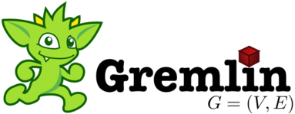
Azure Cosmos DB
A globally distributed, massively scalable, multi-model database service
MongoDB
Table API
Column-family
Document
Key-value
Graph
Elastic scale out
of storage & throughput
Guaranteed low latency at the 99th percentile
Five well-defined consistency models
Turnkey global distribution
Comprehensive SLAs
Notes:
Azure Cosmos DB offers the first globally distributed, multi-model database service for building planet scale apps. It’s been powering Microsoft’s internet-scale services for years, and now it’s ready to launch yours.
Only Azure Cosmos DB makes global distribution turn-key.
You can add Azure locations to your database anywhere across the world, at any time, with a single click. Cosmos DB will seamlessly replicate your data and make it highly available.
Cosmos DB allows you to scale throughput and storage elastically, and globally! You only pay for the throughput and storage you need – anywhere in the world, at any time.

Slide 5
What sets Azure Cosmos DB apart

Slide 6
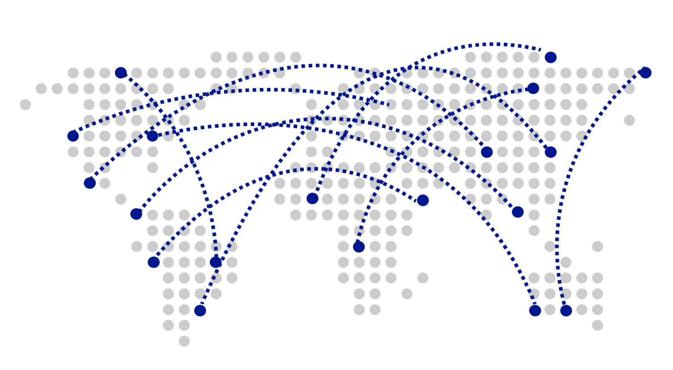
Turnkey Global Distribution
Worldwide presence as a Foundational Azure service
Automatic multi-region replication
Multi-homing APIs
Manual and automatic failovers
Designed for High Availability
Notes:
Cosmos DB is a Foundational (Ring 0) Azure service
Available in all Azure regions by default, including sovereign/government clouds
Transparent and automatic multi-region replication
Associate any number of regions with your database account, at any time
Policy based geo-fencing
Multi-homing APIs
All endpoints are logical, by default
Apps don’t need to be redeployed during regional failover
Apps can also access physical endpoints if needed
Support for both manual and automatic failover
Designed for high availability
Allows for dynamically setting priorities to regions
Simulate regional disasters via API
Test the end-to-end availability for the entire app (beyond just the database)

Slide 7

Guaranteed low latency at P99 (99th percentile)
Requests are served from local region
Single-digit millisecond latency worldwide
Write optimized, latch-free database engine designed for SSD
Synchronous automatic indexing at sustained ingestion rates
Reads
(1KB)
Indexed writes
(1KB)
P50
<2ms
<6ms
P99
<10ms
<15ms
Notes:
Unique design of the quorum based replication protocol
Globally distributed with reads and writes served from local region
Well defined consistency models designed to provide precise consistency guarantees
Unique design of database engine
Write optimized, latch-free database engine designed for SSDs and low latency access
Culmination of decades of database system research in marrying the best of NoSQL techniques for the write path with the Relational query optimized data structures concurrent btree on the read/query path
Benchmarked to have the lowest write and read amplifications.
Better performance and TCO compared to all popular log structured engines LevelDB, RocksDB, TokuDB, WiredTiger
Fully resource governed NO WRITE PAUSES
Synchronous and automatic indexing at sustained ingestion rates
No schema or index management needed
No schema versioning needed
No schema migration needed
All of this is highly relevant for rapidly evolving apps in a globally distributed setup
Cosmos DB guarantees low latency access by serving reads and writes from the local regions. This helps your applications to beat the speed of light or network latency across regions.
Nucleus of Cosmos DB is a write optimized, latch-free database engine which is designed for Solid State Drives. The core design point is low latency and performance and global scale.
Cosmos DB indexes all your data automatically, synchronously at sustained ingestion rates. There is no overhead of secondary indexes as with other databases. Most of us know the pain of managing indexes. Now imagine for a moment maintaining, managing, migrating indexes at global scale. It is almost impossible but with Azure Cosmos DB, you don’t have to. At P99 Cosmos DB guarantees <10ms latency for read access and <15ms for write access. Most applications will experience even lower latency of under <2ms for reads and <6ms for writes.
Several of our large scale cloud services at Microsoft uses Cosmos DB for low latency access. All the device telemetry from windows mobile devices is stored in a globally distributed database and with 100s of millions of devices out there, low latency was a key factor in deciding on the right data store.

Slide 8
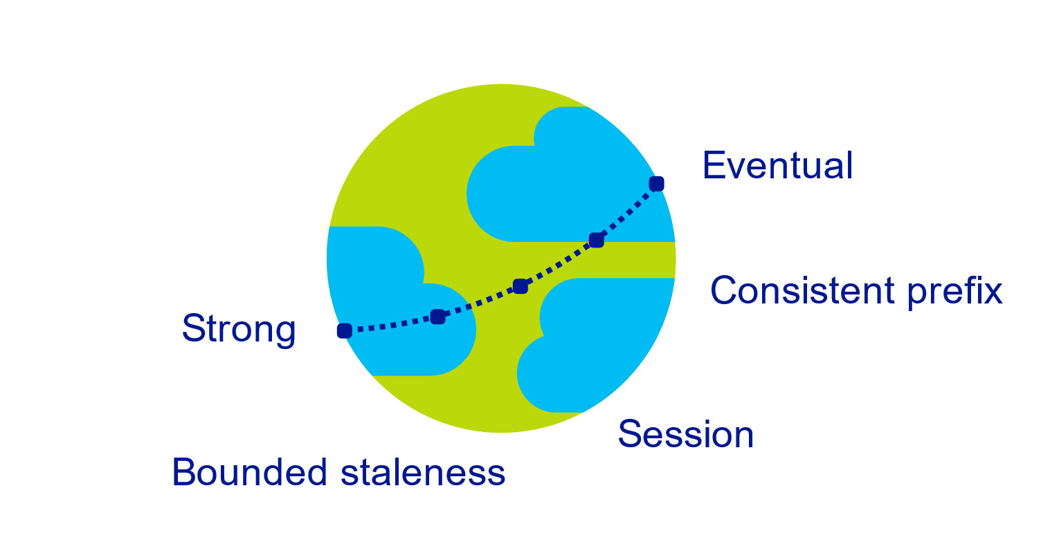
Multiple, well-defined consistency choices
Global distribution forces us to navigate the CAP theorem
Writing correct distributed applications is hard
Five well-defined consistency levels
Intuitive and practical with clear PACELC tradeoffs
Programmatically change at anytime
Can be overridden on a per-request basis
Notes:
Databases are divided into two categories
Provide extreme choices – strong vs. eventual consistency (e.g., DynamoDB)
Leave everything for developers to configure (e.g., Cassandra)
Read repair, Hinted handoff, quorum sizes, replication topologies etc
Developers have to make precise tradeoffs between
Consistency and availability (during failures)
Consistency and latency (during steady state)
Consistency and throughput (this is important for TCO reasons)

Slide 9

Elastically scalable storage and throughput
Single machine is never a bottle neck
Transparent server-side partition management
Elastically scale storage (GB to PB) and throughput (100 to 100M req/sec) across many machines and multiple regions
Automatic expiration via policy based TTL
Pay by the hour, change throughput at any time for only what you need
12000000
10000000
8000000
6000000
4000000
2000000
Black Friday
Provisioned request / sec
Nov 2016
Dec 2016
Time
Hourly throughput (request/sec)
Notes:
Single machine is never a bottleneck
A single table can scale from GB-PBs, across many machines, and regions
Transparent server side partition management and routing
Optionally evict old data using built-in support for TTL
Customers pay only for the throughput and storage they need
Elastically scale throughput from 10 to 100s of millions of requests/sec across multiple regions
Customers pay only for the throughput and storage they need
Customers pay by the hour for the provisioned throughput

Slide 10
Schema-agnostic, automatic indexing
At global scale, schema/index management is painful
Automatic and synchronous indexing
Hash, range, and geospatial
Works across every data model
Highly write-optimized database engine
Schema
Physical index
Notes:
At global scale, schema/index management is hard
Automatic and synchronous indexing of all ingested content - hash, range, geo-spatial, and columnar
No need to define schemas or secondary indices upfront
Resource governed, write optimized database engine with latch free and log structured techniques
Online and in-situ index transformations

Slide 11
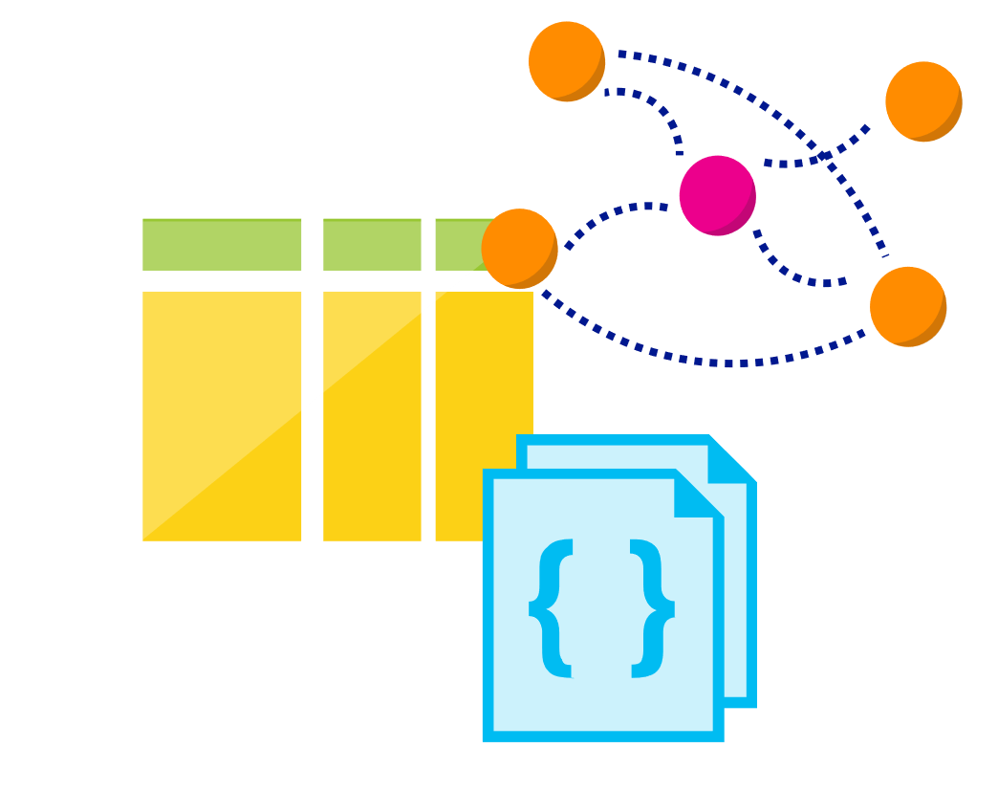
Multi-model, multi-API
Database engine operates on Atom-Record-Sequence type system
All data models can be efficiently translated to ARS
Multi-model: Key-value, Document, Column, and Graph
Multi-API: SQL (DocumentDB), MongoDB, Table, Cassandra and Gremlin
More data-models and APIs to be added
Notes:
Azure Cosmos DB natively supports multiple data models including documents, key-value, graph, and column-family. The core content-model of Cosmos DB’s database engine is based on atom-record-sequence (ARS). Atoms consist of a small set of primitive types like string, bool, and number. Records are structs composed of these types. Sequences are arrays consisting of atoms, records, or sequences.
The database engine can efficiently translate and project different data models onto the ARS-based data model. The core data model of Cosmos DB is natively accessible from dynamically typed programming languages and can be exposed as-is as JSON.
The service also supports popular database APIs for data access and querying. Cosmos DB’s database engine currently supports DocumentDB SQL, MongoDB, Azure Tables(preview), and Gremlin (preview). You can continue to build applications using popular OSS APIs and get all the benefits of a battle-tested and fully managed, globally distributed database service.

Slide 12
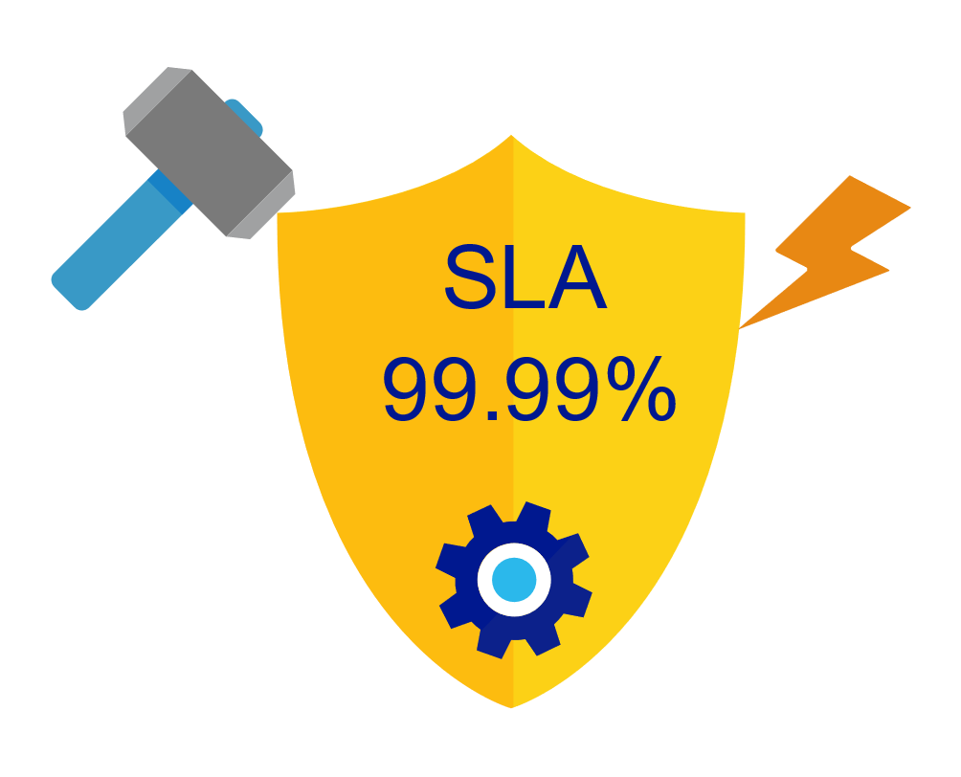
Industry-leading, enterprise-grade SLAs
99.99% availability – even with a single region
Made possible with highly-redundant storage architecture
Guaranteed durability – writes are majority quorum committed
First and only service to offer SLAs on:
Low-latency
Consistency
Throughput
Notes:
Globally distributed database needs to tackle
latency vs. consistency tradeoffs (in steady state)
availability vs. consistency tradeoff (during failures)
throughput vs. consistency tradeoffs during all times
throughput vs. latency tradeoffs during all times
Simply offering high availability SLAs are not sufficient!
Cosmos DB:
99.99% HA within a single region
99.99 SLA throughput, latency, consistency all at the 99th percentile

Slide 13

Security & Compliance
Always encrypted at rest and in transit
Encryption@ Rest – AES256
Encryption @ Transit – SSL / TLS
Fine grained “row level” authorization
User/Permissions with Resource Tokens
Network security with IP firewall rules and VNET
Comprehensive Azure compliance certification:
ISO 27001, ISO 27018, EUMC, HIPAA
PCI, SOC1 and SOC2
FEDRAMP, HITRUST
Notes:
As a foundational Azure Service, Security and Compliance is an important aspect of Azure Cosmos DB. Several high value Microsoft services that have stringent compliance and security requirements are built on Azure Cosmos DB. All of the data is encrypted at rest and it is enabled by default. We made sure that we continue to provide the performance guarantees even with encryption enabled and this is transparent to your application.

Slide 14
Common Use Cases and Scenarios

Slide 15


Globally Distributed Apps
Business Needs:
High scalability to support massive user base
Low latency access across multiple geographies to build highly responsive applications
Automatic indexing over flexible schemas to support rich queries over user-defined content (e.g. custom form builder)
High availability across multiple data centers

Slide 16




Content Management Systems
Azure region A
Azure Cosmos DB
(app + session state)
Azure region B
Azure Traffic Manager
Globally distributed
across regions
Azure region C

Slide 17

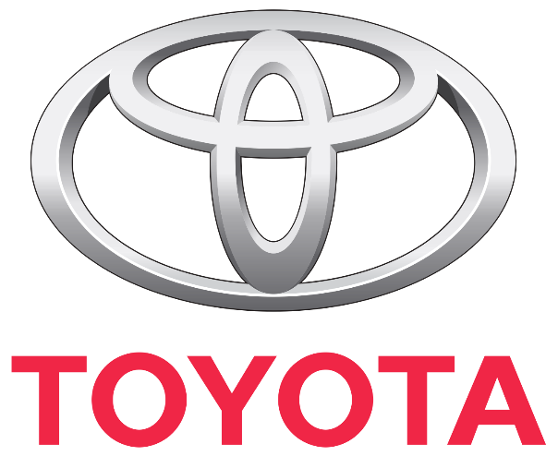



Internet of Things – Telemetry & Sensor Data
Business Needs:
High scalability to ingest large # of events coming from many devices
Low latency queries and changes feeds for responding quickly to anomalies
Schema-agnostic storage and automatic indexing to support dynamic data coming from many different generations of devices
High availability across multiple data centers

Slide 18






Internet of Things – Telemetry & Sensor Data
Azure IoT Hub
Azure Databricks Spark
(Structured Streaming)
Azure Cosmos DB (Hot)
(TTL = 90 days)
Azure API App
(user facing app)
Azure Function
(triggered via Cosmos DB change feed)
Azure Storage (Cold)

Slide 19

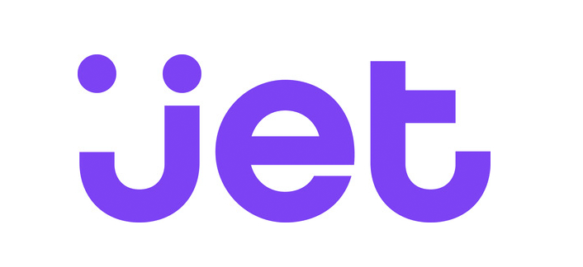



Retail – Product Catalog & Order Processing
Business Needs:
Elastic scale to handle seasonal traffic (e.g. Black Friday)
Low-latency access across multiple geographies to support a global user-base and latency sensitive workloads (e.g. real-time personalization)
Schema-agnostic storage and automatic indexing to handle diverse product catalogs, orders, and events
High availability across multiple data centers

Slide 20

Retail Product Catalogs
Azure Web App
(e-commerce app)
Azure Cosmos DB
(product catalog)
Azure Search (full-text index)
Azure Storage
(logs, static catalog content)
Azure Cosmos DB
(session state)

Slide 21



Retail Order Processing Pipelines
Azure Functions
(E-Commerce Checkout API)
Azure Cosmos DB (Order Event Store)
. . .
Azure Functions
(Microservice 1: Tax)
Azure Functions
(Microservice 2: Payment)
Azure Functions
(Microservice N: Fufillment)

Slide 22

Real-time Recommendations
Online Recommendations Service
Azure Container Service
(Recommendations API)
Azure Cosmos DB
(Product + User Vectors)
Shoppers
E-commerce Store
Apache Spark on
Azure Databricks
Azure Container Service
(Order Transaction API)
Azure Cosmos DB
(Customer Orders)
Order Transactions

Slide 23




Multiplayer Gaming
Business Needs:
Elastic scale to handle bursty traffic on day
Low-latency queries to support responsive gameplay for a global user-base
Schema-agnostic storage and indexing allows teams to iterate quickly to fit a demanding ship schedule
Change-feeds to support leaderboards and social gameplay

Slide 24



Multiplayer Gaming
Azure CDN
Azure Storage
(game files)
Azure API Apps
(game backend)
Azure Cosmos DB
(game database)
Azure Databricks
(game analytics)
Azure Traffic Manager
Azure Functions
Azure Notification Hubs
(push notifications)

Slide 25



Customer 360 + Operational Analytics
Business Needs:
High scalability to handle large user base
Rich queries and automatic indexing over flexible schemas to consolidate data from a variety of sources
Built-in aggregates and efficient spark connector to analyze user behavior, drive insights, and build a single view of the customer.

Slide 26

Customer 360 + Social Analytics
1st-Party and 3rd-Party
Data Sources
Azure Cosmos DB
(Master Data)
Spark on
Azure HDInsight

Slide 27
Scale-out Computation
Spark SQL
Spark Streaming
GraphX (graph)
MLlib (machine learning)
Apache Spark on Databricks
Scale-out Database
Spark Connector using SQL API
Azure Cosmos DB

Slide 28

Messaging
Business Needs:
High scalability to ingest and store messages from a massive user base
Low latency access across multiple geographies to support global user-base
High availability across multiple data centers

Slide 29
Messaging
Week 0
Azure Cosmos DB
(message data – partitioned by userid)
Azure Search
(full-text index)
Azure Web App
(messaging app)

Slide 30
Messaging
Week 0
Azure Cosmos DB
(message data – partitioned by userid)
Azure Search
(full-text index)
Week 1
Azure Web App
(messaging app)
Azure Cosmos DB
(message data – partitioned by userid)
Azure Search
(full-text index)

Slide 31
Messaging
Week 0
Azure Cosmos DB
(message data – partitioned by userid)
Azure Search
(full-text index)
Week 1
Azure Web App
(messaging app)
Azure Cosmos DB
(message data – partitioned by userid)
Azure Search
(full-text index)
Week 2
Azure Cosmos DB
(message data – partitioned by userid)
Azure Search
(full-text index)

Slide 32

Let’s zoom in Azure Cosmos DB

Slide 33
Resource Model

Slide 34
Account
Database
Container
Item
Notes:
A tenant of the Cosmos DB service starts by provisioning a database account. A database account manages one or more databases. A Cosmos DB database manages users, permissions and containers. A Cosmos DB resource container is a schema-agnostic container of arbitrary user-generated JSON items and JavaScript based stored procedures, triggers and user-defined-functions (UDFs). Entities under the tenant’s database account – databases, users, permissions, containers etc. are referred to as resources.
Each resource is uniquely identified by a stable and logical URI and represented as a JSON document. The overall resource model of an application using Cosmos DB is a hierarchical overlay of the resources rooted under the database account, and can be navigated using hyperlinks. Except for the item resource, which is used to represent arbitrary user defined JSON content, all other resources have a system-defined schema.
Container and item resources are further projected as reified resource types for a specific type of API interface. For example, while using document-oriented APIs, container and item resources are projected as collection (container) and document (item) resources, respectively; likewise, for graph-oriented API access, the underlying container and item resources are projected as graph (container), node (item) and edge (item) resources respectively; while accessing using a key-value API table (container) and item/row (item) are projected.

Slide 35


********.azure.com
Account
Database
IGeAvVUp …
Container
Item
Notes:
A tenant of the Cosmos DB service starts by provisioning a database account. A database account manages one or more databases. A Cosmos DB database manages users, permissions and containers. A Cosmos DB resource container is a schema-agnostic container of arbitrary user-generated JSON items and JavaScript based stored procedures, triggers and user-defined-functions (UDFs). Entities under the tenant’s database account – databases, users, permissions, containers etc. are referred to as resources.
Each resource is uniquely identified by a stable and logical URI and represented as a JSON document. The overall resource model of an application using Cosmos DB is a hierarchical overlay of the resources rooted under the database account, and can be navigated using hyperlinks. Except for the item resource, which is used to represent arbitrary user defined JSON content, all other resources have a system-defined schema.
Container and item resources are further projected as reified resource types for a specific type of API interface. For example, while using document-oriented APIs, container and item resources are projected as collection (container) and document (item) resources, respectively; likewise, for graph-oriented API access, the underlying container and item resources are projected as graph (container), node (item) and edge (item) resources respectively; while accessing using a key-value API table (container) and item/row (item) are projected.

Slide 36
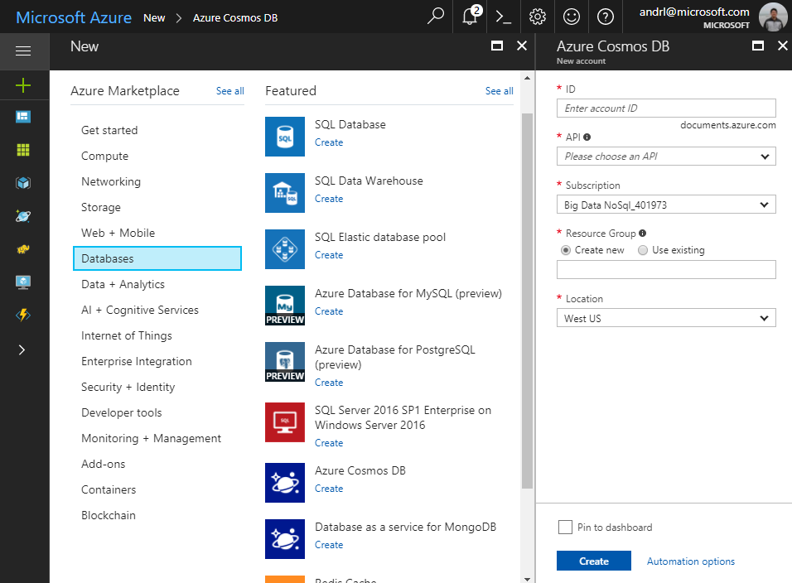
Account
Database
Container
Item
Notes:
A tenant of the Cosmos DB service starts by provisioning a database account. A database account manages one or more databases. A Cosmos DB database manages users, permissions and containers. A Cosmos DB resource container is a schema-agnostic container of arbitrary user-generated JSON items and JavaScript based stored procedures, triggers and user-defined-functions (UDFs). Entities under the tenant’s database account – databases, users, permissions, containers etc. are referred to as resources.
Each resource is uniquely identified by a stable and logical URI and represented as a JSON document. The overall resource model of an application using Cosmos DB is a hierarchical overlay of the resources rooted under the database account, and can be navigated using hyperlinks. Except for the item resource, which is used to represent arbitrary user defined JSON content, all other resources have a system-defined schema.
Container and item resources are further projected as reified resource types for a specific type of API interface. For example, while using document-oriented APIs, container and item resources are projected as collection (container) and document (item) resources, respectively; likewise, for graph-oriented API access, the underlying container and item resources are projected as graph (container), node (item) and edge (item) resources respectively; while accessing using a key-value API table (container) and item/row (item) are projected.

Slide 37
Account
Database
Container
Item
Notes:
A tenant of the Cosmos DB service starts by provisioning a database account. A database account manages one or more databases. A Cosmos DB database manages users, permissions and containers. A Cosmos DB resource container is a schema-agnostic container of arbitrary user-generated JSON items and JavaScript based stored procedures, triggers and user-defined-functions (UDFs). Entities under the tenant’s database account – databases, users, permissions, containers etc. are referred to as resources.
Each resource is uniquely identified by a stable and logical URI and represented as a JSON document. The overall resource model of an application using Cosmos DB is a hierarchical overlay of the resources rooted under the database account, and can be navigated using hyperlinks. Except for the item resource, which is used to represent arbitrary user defined JSON content, all other resources have a system-defined schema.
Container and item resources are further projected as reified resource types for a specific type of API interface. For example, while using document-oriented APIs, container and item resources are projected as collection (container) and document (item) resources, respectively; likewise, for graph-oriented API access, the underlying container and item resources are projected as graph (container), node (item) and edge (item) resources respectively; while accessing using a key-value API table (container) and item/row (item) are projected.

Slide 38
Account
Database
Container
Item
Notes:
A tenant of the Cosmos DB service starts by provisioning a database account. A database account manages one or more databases. A Cosmos DB database manages users, permissions and containers. A Cosmos DB resource container is a schema-agnostic container of arbitrary user-generated JSON items and JavaScript based stored procedures, triggers and user-defined-functions (UDFs). Entities under the tenant’s database account – databases, users, permissions, containers etc. are referred to as resources.
Each resource is uniquely identified by a stable and logical URI and represented as a JSON document. The overall resource model of an application using Cosmos DB is a hierarchical overlay of the resources rooted under the database account, and can be navigated using hyperlinks. Except for the item resource, which is used to represent arbitrary user defined JSON content, all other resources have a system-defined schema.
Container and item resources are further projected as reified resource types for a specific type of API interface. For example, while using document-oriented APIs, container and item resources are projected as collection (container) and document (item) resources, respectively; likewise, for graph-oriented API access, the underlying container and item resources are projected as graph (container), node (item) and edge (item) resources respectively; while accessing using a key-value API table (container) and item/row (item) are projected.

Slide 39
Account
Database
Container
Item
Notes:
A tenant of the Cosmos DB service starts by provisioning a database account. A database account manages one or more databases. A Cosmos DB database manages users, permissions and containers. A Cosmos DB resource container is a schema-agnostic container of arbitrary user-generated JSON items and JavaScript based stored procedures, triggers and user-defined-functions (UDFs). Entities under the tenant’s database account – databases, users, permissions, containers etc. are referred to as resources.
Each resource is uniquely identified by a stable and logical URI and represented as a JSON document. The overall resource model of an application using Cosmos DB is a hierarchical overlay of the resources rooted under the database account, and can be navigated using hyperlinks. Except for the item resource, which is used to represent arbitrary user defined JSON content, all other resources have a system-defined schema.
Container and item resources are further projected as reified resource types for a specific type of API interface. For example, while using document-oriented APIs, container and item resources are projected as collection (container) and document (item) resources, respectively; likewise, for graph-oriented API access, the underlying container and item resources are projected as graph (container), node (item) and edge (item) resources respectively; while accessing using a key-value API table (container) and item/row (item) are projected.

Slide 40
Account
Database
Container
Item
Notes:
A tenant of the Cosmos DB service starts by provisioning a database account. A database account manages one or more databases. A Cosmos DB database manages users, permissions and containers. A Cosmos DB resource container is a schema-agnostic container of arbitrary user-generated JSON items and JavaScript based stored procedures, triggers and user-defined-functions (UDFs). Entities under the tenant’s database account – databases, users, permissions, containers etc. are referred to as resources.
Each resource is uniquely identified by a stable and logical URI and represented as a JSON document. The overall resource model of an application using Cosmos DB is a hierarchical overlay of the resources rooted under the database account, and can be navigated using hyperlinks. Except for the item resource, which is used to represent arbitrary user defined JSON content, all other resources have a system-defined schema.
Container and item resources are further projected as reified resource types for a specific type of API interface. For example, while using document-oriented APIs, container and item resources are projected as collection (container) and document (item) resources, respectively; likewise, for graph-oriented API access, the underlying container and item resources are projected as graph (container), node (item) and edge (item) resources respectively; while accessing using a key-value API table (container) and item/row (item) are projected.

Slide 41
Account
Database
Container
Item
Notes:
A tenant of the Cosmos DB service starts by provisioning a database account. A database account manages one or more databases. A Cosmos DB database manages users, permissions and containers. A Cosmos DB resource container is a schema-agnostic container of arbitrary user-generated JSON items and JavaScript based stored procedures, triggers and user-defined-functions (UDFs). Entities under the tenant’s database account – databases, users, permissions, containers etc. are referred to as resources.
Each resource is uniquely identified by a stable and logical URI and represented as a JSON document. The overall resource model of an application using Cosmos DB is a hierarchical overlay of the resources rooted under the database account, and can be navigated using hyperlinks. Except for the item resource, which is used to represent arbitrary user defined JSON content, all other resources have a system-defined schema.
Container and item resources are further projected as reified resource types for a specific type of API interface. For example, while using document-oriented APIs, container and item resources are projected as collection (container) and document (item) resources, respectively; likewise, for graph-oriented API access, the underlying container and item resources are projected as graph (container), node (item) and edge (item) resources respectively; while accessing using a key-value API table (container) and item/row (item) are projected.

Slide 42
Account
Database
Container
Item
Notes:
A tenant of the Cosmos DB service starts by provisioning a database account. A database account manages one or more databases. A Cosmos DB database manages users, permissions and containers. A Cosmos DB resource container is a schema-agnostic container of arbitrary user-generated JSON items and JavaScript based stored procedures, triggers and user-defined-functions (UDFs). Entities under the tenant’s database account – databases, users, permissions, containers etc. are referred to as resources.
Each resource is uniquely identified by a stable and logical URI and represented as a JSON document. The overall resource model of an application using Cosmos DB is a hierarchical overlay of the resources rooted under the database account, and can be navigated using hyperlinks. Except for the item resource, which is used to represent arbitrary user defined JSON content, all other resources have a system-defined schema.
Container and item resources are further projected as reified resource types for a specific type of API interface. For example, while using document-oriented APIs, container and item resources are projected as collection (container) and document (item) resources, respectively; likewise, for graph-oriented API access, the underlying container and item resources are projected as graph (container), node (item) and edge (item) resources respectively; while accessing using a key-value API table (container) and item/row (item) are projected.

Slide 43
Account
Database
Container
Item
Notes:
A tenant of the Cosmos DB service starts by provisioning a database account. A database account manages one or more databases. A Cosmos DB database manages users, permissions and containers. A Cosmos DB resource container is a schema-agnostic container of arbitrary user-generated JSON items and JavaScript based stored procedures, triggers and user-defined-functions (UDFs). Entities under the tenant’s database account – databases, users, permissions, containers etc. are referred to as resources.
Each resource is uniquely identified by a stable and logical URI and represented as a JSON document. The overall resource model of an application using Cosmos DB is a hierarchical overlay of the resources rooted under the database account, and can be navigated using hyperlinks. Except for the item resource, which is used to represent arbitrary user defined JSON content, all other resources have a system-defined schema.
Container and item resources are further projected as reified resource types for a specific type of API interface. For example, while using document-oriented APIs, container and item resources are projected as collection (container) and document (item) resources, respectively; likewise, for graph-oriented API access, the underlying container and item resources are projected as graph (container), node (item) and edge (item) resources respectively; while accessing using a key-value API table (container) and item/row (item) are projected.

Slide 44
Account
Database
Container
Item
Notes:
A tenant of the Cosmos DB service starts by provisioning a database account. A database account manages one or more databases. A Cosmos DB database manages users, permissions and containers. A Cosmos DB resource container is a schema-agnostic container of arbitrary user-generated JSON items and JavaScript based stored procedures, triggers and user-defined-functions (UDFs). Entities under the tenant’s database account – databases, users, permissions, containers etc. are referred to as resources.
Each resource is uniquely identified by a stable and logical URI and represented as a JSON document. The overall resource model of an application using Cosmos DB is a hierarchical overlay of the resources rooted under the database account, and can be navigated using hyperlinks. Except for the item resource, which is used to represent arbitrary user defined JSON content, all other resources have a system-defined schema.
Container and item resources are further projected as reified resource types for a specific type of API interface. For example, while using document-oriented APIs, container and item resources are projected as collection (container) and document (item) resources, respectively; likewise, for graph-oriented API access, the underlying container and item resources are projected as graph (container), node (item) and edge (item) resources respectively; while accessing using a key-value API table (container) and item/row (item) are projected.

Slide 45
Account
Database
Container
Item
Notes:
A tenant of the Cosmos DB service starts by provisioning a database account. A database account manages one or more databases. A Cosmos DB database manages users, permissions and containers. A Cosmos DB resource container is a schema-agnostic container of arbitrary user-generated JSON items and JavaScript based stored procedures, triggers and user-defined-functions (UDFs). Entities under the tenant’s database account – databases, users, permissions, containers etc. are referred to as resources.
Each resource is uniquely identified by a stable and logical URI and represented as a JSON document. The overall resource model of an application using Cosmos DB is a hierarchical overlay of the resources rooted under the database account, and can be navigated using hyperlinks. Except for the item resource, which is used to represent arbitrary user defined JSON content, all other resources have a system-defined schema.
Container and item resources are further projected as reified resource types for a specific type of API interface. For example, while using document-oriented APIs, container and item resources are projected as collection (container) and document (item) resources, respectively; likewise, for graph-oriented API access, the underlying container and item resources are projected as graph (container), node (item) and edge (item) resources respectively; while accessing using a key-value API table (container) and item/row (item) are projected.

Slide 46
Account
Database
Container
User
Item
Permission
Notes:
A tenant of the Cosmos DB service starts by provisioning a database account. A database account manages one or more databases. A Cosmos DB database manages users, permissions and containers. A Cosmos DB resource container is a schema-agnostic container of arbitrary user-generated JSON items and JavaScript based stored procedures, triggers and user-defined-functions (UDFs). Entities under the tenant’s database account – databases, users, permissions, containers etc. are referred to as resources.
Each resource is uniquely identified by a stable and logical URI and represented as a JSON document. The overall resource model of an application using Cosmos DB is a hierarchical overlay of the resources rooted under the database account, and can be navigated using hyperlinks. Except for the item resource, which is used to represent arbitrary user defined JSON content, all other resources have a system-defined schema.
Container and item resources are further projected as reified resource types for a specific type of API interface. For example, while using document-oriented APIs, container and item resources are projected as collection (container) and document (item) resources, respectively; likewise, for graph-oriented API access, the underlying container and item resources are projected as graph (container), node (item) and edge (item) resources respectively; while accessing using a key-value API table (container) and item/row (item) are projected.

Slide 47
Account
Database
Container
=
Collection
Graph
Table
Item
Notes:
A tenant of the Cosmos DB service starts by provisioning a database account. A database account manages one or more databases. A Cosmos DB database manages users, permissions and containers. A Cosmos DB resource container is a schema-agnostic container of arbitrary user-generated JSON items and JavaScript based stored procedures, triggers and user-defined-functions (UDFs). Entities under the tenant’s database account – databases, users, permissions, containers etc. are referred to as resources.
Each resource is uniquely identified by a stable and logical URI and represented as a JSON document. The overall resource model of an application using Cosmos DB is a hierarchical overlay of the resources rooted under the database account, and can be navigated using hyperlinks. Except for the item resource, which is used to represent arbitrary user defined JSON content, all other resources have a system-defined schema.
Container and item resources are further projected as reified resource types for a specific type of API interface. For example, while using document-oriented APIs, container and item resources are projected as collection (container) and document (item) resources, respectively; likewise, for graph-oriented API access, the underlying container and item resources are projected as graph (container), node (item) and edge (item) resources respectively; while accessing using a key-value API table (container) and item/row (item) are projected.

Slide 48
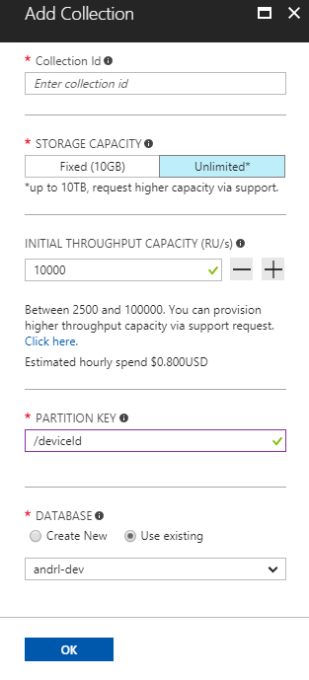
Account
Database
Container
Item
Notes:
A tenant of the Cosmos DB service starts by provisioning a database account. A database account manages one or more databases. A Cosmos DB database manages users, permissions and containers. A Cosmos DB resource container is a schema-agnostic container of arbitrary user-generated JSON items and JavaScript based stored procedures, triggers and user-defined-functions (UDFs). Entities under the tenant’s database account – databases, users, permissions, containers etc. are referred to as resources.
Each resource is uniquely identified by a stable and logical URI and represented as a JSON document. The overall resource model of an application using Cosmos DB is a hierarchical overlay of the resources rooted under the database account, and can be navigated using hyperlinks. Except for the item resource, which is used to represent arbitrary user defined JSON content, all other resources have a system-defined schema.
Container and item resources are further projected as reified resource types for a specific type of API interface. For example, while using document-oriented APIs, container and item resources are projected as collection (container) and document (item) resources, respectively; likewise, for graph-oriented API access, the underlying container and item resources are projected as graph (container), node (item) and edge (item) resources respectively; while accessing using a key-value API table (container) and item/row (item) are projected.

Slide 49
Account
Database
Container
Item
Notes:
A tenant of the Cosmos DB service starts by provisioning a database account. A database account manages one or more databases. A Cosmos DB database manages users, permissions and containers. A Cosmos DB resource container is a schema-agnostic container of arbitrary user-generated JSON items and JavaScript based stored procedures, triggers and user-defined-functions (UDFs). Entities under the tenant’s database account – databases, users, permissions, containers etc. are referred to as resources.
Each resource is uniquely identified by a stable and logical URI and represented as a JSON document. The overall resource model of an application using Cosmos DB is a hierarchical overlay of the resources rooted under the database account, and can be navigated using hyperlinks. Except for the item resource, which is used to represent arbitrary user defined JSON content, all other resources have a system-defined schema.
Container and item resources are further projected as reified resource types for a specific type of API interface. For example, while using document-oriented APIs, container and item resources are projected as collection (container) and document (item) resources, respectively; likewise, for graph-oriented API access, the underlying container and item resources are projected as graph (container), node (item) and edge (item) resources respectively; while accessing using a key-value API table (container) and item/row (item) are projected.

Slide 50
Account
Database
Container
Note: Throughput can also be shared across a set of collections
Item
Notes:
A tenant of the Cosmos DB service starts by provisioning a database account. A database account manages one or more databases. A Cosmos DB database manages users, permissions and containers. A Cosmos DB resource container is a schema-agnostic container of arbitrary user-generated JSON items and JavaScript based stored procedures, triggers and user-defined-functions (UDFs). Entities under the tenant’s database account – databases, users, permissions, containers etc. are referred to as resources.
Each resource is uniquely identified by a stable and logical URI and represented as a JSON document. The overall resource model of an application using Cosmos DB is a hierarchical overlay of the resources rooted under the database account, and can be navigated using hyperlinks. Except for the item resource, which is used to represent arbitrary user defined JSON content, all other resources have a system-defined schema.
Container and item resources are further projected as reified resource types for a specific type of API interface. For example, while using document-oriented APIs, container and item resources are projected as collection (container) and document (item) resources, respectively; likewise, for graph-oriented API access, the underlying container and item resources are projected as graph (container), node (item) and edge (item) resources respectively; while accessing using a key-value API table (container) and item/row (item) are projected.

Slide 51
Account
Database
Container
Item
Notes:
A tenant of the Cosmos DB service starts by provisioning a database account. A database account manages one or more databases. A Cosmos DB database manages users, permissions and containers. A Cosmos DB resource container is a schema-agnostic container of arbitrary user-generated JSON items and JavaScript based stored procedures, triggers and user-defined-functions (UDFs). Entities under the tenant’s database account – databases, users, permissions, containers etc. are referred to as resources.
Each resource is uniquely identified by a stable and logical URI and represented as a JSON document. The overall resource model of an application using Cosmos DB is a hierarchical overlay of the resources rooted under the database account, and can be navigated using hyperlinks. Except for the item resource, which is used to represent arbitrary user defined JSON content, all other resources have a system-defined schema.
Container and item resources are further projected as reified resource types for a specific type of API interface. For example, while using document-oriented APIs, container and item resources are projected as collection (container) and document (item) resources, respectively; likewise, for graph-oriented API access, the underlying container and item resources are projected as graph (container), node (item) and edge (item) resources respectively; while accessing using a key-value API table (container) and item/row (item) are projected.

Slide 52
Account
Database
Container
Item
Notes:
A tenant of the Cosmos DB service starts by provisioning a database account. A database account manages one or more databases. A Cosmos DB database manages users, permissions and containers. A Cosmos DB resource container is a schema-agnostic container of arbitrary user-generated JSON items and JavaScript based stored procedures, triggers and user-defined-functions (UDFs). Entities under the tenant’s database account – databases, users, permissions, containers etc. are referred to as resources.
Each resource is uniquely identified by a stable and logical URI and represented as a JSON document. The overall resource model of an application using Cosmos DB is a hierarchical overlay of the resources rooted under the database account, and can be navigated using hyperlinks. Except for the item resource, which is used to represent arbitrary user defined JSON content, all other resources have a system-defined schema.
Container and item resources are further projected as reified resource types for a specific type of API interface. For example, while using document-oriented APIs, container and item resources are projected as collection (container) and document (item) resources, respectively; likewise, for graph-oriented API access, the underlying container and item resources are projected as graph (container), node (item) and edge (item) resources respectively; while accessing using a key-value API table (container) and item/row (item) are projected.

Slide 53
Account
Database
Container
Item
Sproc
Trigger
UDF
Notes:
A tenant of the Cosmos DB service starts by provisioning a database account. A database account manages one or more databases. A Cosmos DB database manages users, permissions and containers. A Cosmos DB resource container is a schema-agnostic container of arbitrary user-generated JSON items and JavaScript based stored procedures, triggers and user-defined-functions (UDFs). Entities under the tenant’s database account – databases, users, permissions, containers etc. are referred to as resources.
Each resource is uniquely identified by a stable and logical URI and represented as a JSON document. The overall resource model of an application using Cosmos DB is a hierarchical overlay of the resources rooted under the database account, and can be navigated using hyperlinks. Except for the item resource, which is used to represent arbitrary user defined JSON content, all other resources have a system-defined schema.
Container and item resources are further projected as reified resource types for a specific type of API interface. For example, while using document-oriented APIs, container and item resources are projected as collection (container) and document (item) resources, respectively; likewise, for graph-oriented API access, the underlying container and item resources are projected as graph (container), node (item) and edge (item) resources respectively; while accessing using a key-value API table (container) and item/row (item) are projected.

Slide 54
Account
Database
Container
Item
Sproc
Trigger
UDF
Conflict
Notes:
A tenant of the Cosmos DB service starts by provisioning a database account. A database account manages one or more databases. A Cosmos DB database manages users, permissions and containers. A Cosmos DB resource container is a schema-agnostic container of arbitrary user-generated JSON items and JavaScript based stored procedures, triggers and user-defined-functions (UDFs). Entities under the tenant’s database account – databases, users, permissions, containers etc. are referred to as resources.
Each resource is uniquely identified by a stable and logical URI and represented as a JSON document. The overall resource model of an application using Cosmos DB is a hierarchical overlay of the resources rooted under the database account, and can be navigated using hyperlinks. Except for the item resource, which is used to represent arbitrary user defined JSON content, all other resources have a system-defined schema.
Container and item resources are further projected as reified resource types for a specific type of API interface. For example, while using document-oriented APIs, container and item resources are projected as collection (container) and document (item) resources, respectively; likewise, for graph-oriented API access, the underlying container and item resources are projected as graph (container), node (item) and edge (item) resources respectively; while accessing using a key-value API table (container) and item/row (item) are projected.

Slide 55
System Internals

Slide 56
System design (logical)
Tenants
Follower
Follower
Collections
Graphs
Leader
Forwarder
Tables
Replica set
To a remote resource partition(s)
Container
Container
Container
Resource Partition
A consistent, highly available, and resource governed coordination primitive
Consists of a replica set with each replica hosting an instance of database engine
Uniquely belongs to a tenant
Owns a set of keys
Containers
…
Resource Partitions

Slide 57
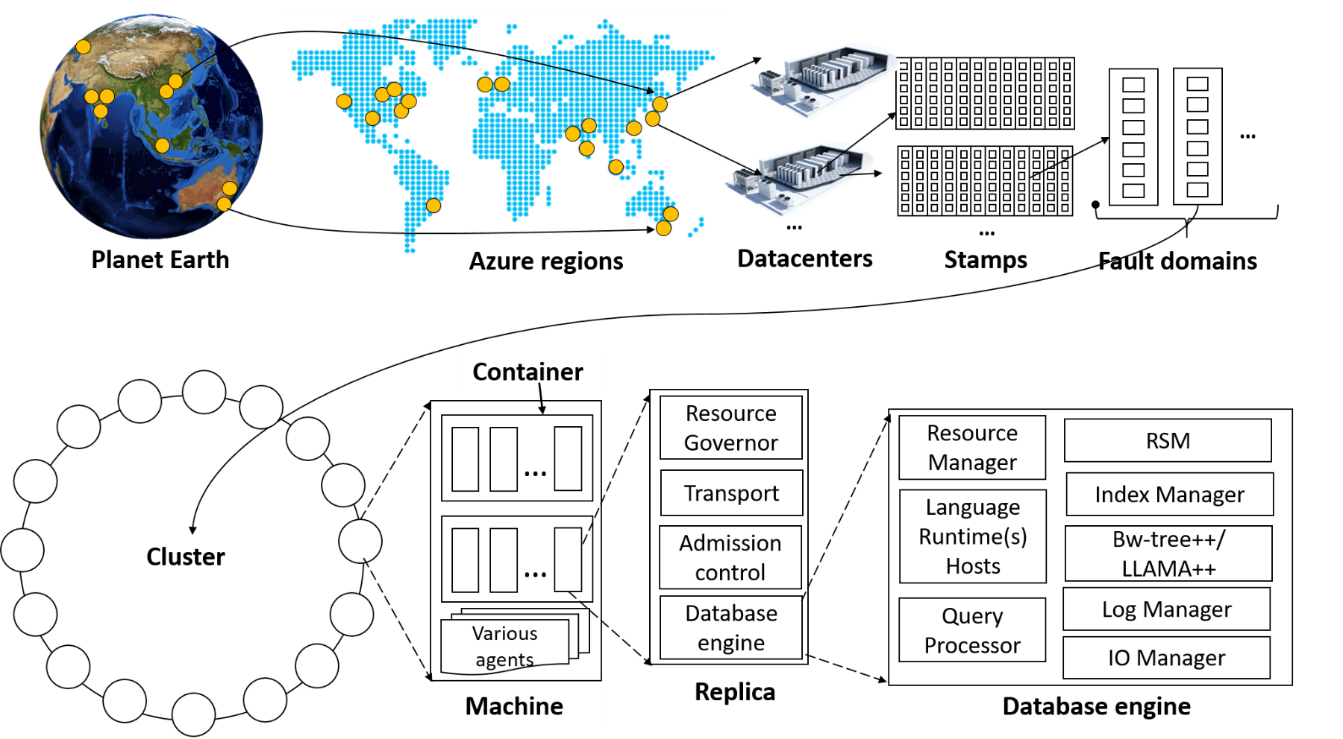
System topology (behind the scenes)
Notes:
The Cosmos DB service is deployed worldwide across all Azure regions including the sovereign and government clouds. We deploy and manage the Cosmos DB service on stamps of machines, each with dedicated local SSDs. The Cosmos DB service is layered on top of Azure Service Fabric, which is a foundational distributed systems infrastructure of Azure. Cosmos DB uses Service Fabric for naming, routing, cluster and container management, coordination of rolling upgrades, failure detection, leader election (within a resource partition) and load balancing capabilities. Cosmos DB is deployed across one or more Service Fabric clusters, each potentially running multiple generations of hardware and of varying number of machines (currently, between 60-800 machines).
Machines within a cluster typically are spread across 10-20 fault domains. The resource partitions is a logical concept. Physically, a resource partition is implemented in terms of a group of replicas, called replica-sets. Each machine hosts replicas corresponding to various resource partitions within a fixed set of processes. Replicas corresponding to the resource partitions are placed and load balanced across these machines. Each replica hosts an instance of Cosmos DB’s schema-agnostic database engine, which manages the resources as well as the associated indexes. The Cosmos DB database engine, in-turn, consists of components including implementation of several coordination primitives, the JavaScript language runtime, the query processor, the storage and indexing subsystems responsible for transactional storage and indexing of data, respectively. To provide durability and high availability, the database engine persists its index on SSDs and replicates it among the database engine instances within the replica-set(s) respectively. While the index is always persisted on local SSDs, the log is persisted either locally, on another machine within the cluster, or remotely across cluster or a datacenter within a region. The proximity of the index and log is configurable based on the price and latency SLA. The ability to dynamically configure the proximity between the database engine (compute) and log (storage) at the granularity of replicas of a resource partition is crucial for allowing tenants to dynamically select various service tiers.

Slide 58
Request Units

Slide 59
% CPU
Request Units
Request Units (RU) is a rate-based currency
Abstracts physical resources for performing requests
Key to providing isolation in a multi-tenant environment
Enables SLAs for predictable performance
Foreground and background activities
% Memory
% IOPS
Notes:
Azure Cosmos DB is designed to allow customers to elastically scale throughput based on the application traffic patterns across different regions to support fluctuating workloads varying both by geography and time. Operating hundreds of thousands of globally distributed and diverse workloads cost-effectively requires fine-grained multi-tenancy, where hundreds of customers share the same machine and yet thousands share the same cluster. To provide performance isolation to each customer while operating cost-effectively, we’ve engineered the entire system from the ground up with resource governance in mind. As a resource governed system, Azure Cosmos DB is a massively distributed queuing system with cascaded stages of components, each carefully calibrated to deliver predictable throughput while operating within the allotted budget of system resources. In order to optimally utilize the system resources (CPU, memory, disk, and network) available within a given cluster, every machine in the cluster is capable of dynamically hosting from 10s to 100s of customers. Rate-limiting and back-pressure are plumbed across the entire stack from the admission control to all I/O paths. Our database engine is designed to exploit fine-grained concurrency and to deliver high throughput while operating within frugal amounts of system resources.

Slide 60
GET
Request Units
Normalized across various access methods
1 RU = 1 read of 1 KB record
Each request consumes fixed RUs
Applies to reads, writes, queries, and stored procedure execution
POST
PUT
Query
…
Notes:
The number of database operations issued within a unit of time (i.e., throughput) is the fundamental unit of reservation and consumption of system resources. Customers can perform wide range of database operations against their data. Depending on the operation type and the size of (the request and response) payload the operation may consume different amounts of system resources. In order to provide a normalized model for accounting the resources consumed by a request, budget system resources corresponding to the throughput a given resource partition needs to deliver, and charge the customers for throughput across various database operations consistently and in a hardware agnostic manner, we have defined an abstract rate-based currency for throughput called Request Unit or RU, which is available in two denominations based on the time granularity - request units/sec (RU/s) and request units per minute (RU/m).

Slide 61
Request Units
Provisioned in terms of RU/sec
Rate limiting based on amount of throughput provisioned
Can be increased or decreased instantaneously
Billing is metered hourly
Background processes like TTL expiration, index transformations scheduled when quiescent
Rate limit
Max RU/sec
No throttling
Incoming Requests
Min RU/sec
Replica
Quiescent
Notes:
Customers can elastically scale throughput of a container by programmatically provisioning RU/s (and/or RU/m) on a container. Internally, the system manages resource partitions to deliver the throughput on a given container. Elastically scaling throughput using horizontally partitioning of resources requires that each resource partition is capable of delivering the portion of the overall throughput for a given budget of system resources.
As part of the admission control, each resource partition employs adaptive rate limiting. If the resource partition receives more requests within a second than it was calibrated against, the client will receive “request rate too large” with a back-off interval after which the client can retry. Within each second, a resource partition performs (rate limited) background chores (e.g., background GC of the log structured database engine, taking periodic snapshot backups, deleting expired items etc.) within the spare capacity of RUs (if any). Once a request is admitted, we account for the RUs consumed by each micro-operation (e.g., analyzing an item, reading/writing a page, or executing a query operator).

Slide 62
Pricing Example
Storage Cost
Avg Record Size (KB) | 1
Number of Records | 100,000,000
* pricing may vary by region; for up-to-date pricing, see: https://azure.microsoft.com/pricing/details/cosmos-db/

Slide 63
Pricing Example
Storage Cost
Avg Record Size (KB) | 1
Number of Records | 100,000,000
Total Storage (GB) | 100
Monthly Cost per GB | $0.25
* pricing may vary by region; for up-to-date pricing, see: https://azure.microsoft.com/pricing/details/cosmos-db/

Slide 64
Pricing Example
Storage Cost
Avg Record Size (KB) | 1
Number of Records | 100,000,000
Total Storage (GB) | 100
Monthly Cost per GB | $0.25
Expected Monthly Cost for Storage | $25.00
* pricing may vary by region; for up-to-date pricing, see: https://azure.microsoft.com/pricing/details/cosmos-db/

Slide 65
Pricing Example
Storage Cost
Avg Record Size (KB) | 1
Number of Records | 100,000,000
Total Storage (GB) | 100
Monthly Cost per GB | $0.25
Expected Monthly Cost for Storage | $25.00
Throughput Cost
Operation Type | Number of Requests per Second | Avg RU's per Request | RU's Needed
Create | 100 | 5 | 500
Read | 400 | 1 | 400
* pricing may vary by region; for up-to-date pricing, see: https://azure.microsoft.com/pricing/details/cosmos-db/

Slide 66
Pricing Example
Storage Cost
Avg Record Size (KB) | 1
Number of Records | 100,000,000
Total Storage (GB) | 100
Monthly Cost per GB | $0.25
Expected Monthly Cost for Storage | $25.00
Throughput Cost
Operation Type | Number of Requests per Second | Avg RU's per Request | RU's Needed
Create | 100 | 5 | 500
Read | 400 | 1 | 400
Total RU/sec | 900
Monthly Cost per 100 RU/sec | $6.00
* pricing may vary by region; for up-to-date pricing, see: https://azure.microsoft.com/pricing/details/cosmos-db/

Slide 67
Pricing Example
Storage Cost
Avg Record Size (KB) | 1
Number of Records | 100,000,000
Total Storage (GB) | 100
Monthly Cost per GB | $0.25
Expected Monthly Cost for Storage | $25.00
Throughput Cost
Operation Type | Number of Requests per Second | Avg RU's per Request | RU's Needed
Create | 100 | 5 | 500
Read | 400 | 1 | 400
Total RU/sec | 900
Monthly Cost per 100 RU/sec | $6.00
Expected Monthly Cost for Throughput | $54.00
* pricing may vary by region; for up-to-date pricing, see: https://azure.microsoft.com/pricing/details/cosmos-db/

Slide 68
Pricing Example
Storage Cost
Avg Record Size (KB) | 1
Number of Records | 100,000,000
Total Storage (GB) | 100
Monthly Cost per GB | $0.25
Expected Monthly Cost for Storage | $25.00
Throughput Cost
Operation Type | Number of Requests per Second | Avg RU's per Request | RU's Needed
Create | 100 | 5 | 500
Read | 400 | 1 | 400
Total RU/sec | 900
Monthly Cost per 100 RU/sec | $6.00
Expected Monthly Cost for Throughput | $54.00
Total Monthly Cost
[Total Monthly Cost] = [Monthly Cost for Storage] + [Monthly Cost for Throughput]
= $25 + $54
= $79 per month
* pricing may vary by region; for up-to-date pricing, see: https://azure.microsoft.com/pricing/details/cosmos-db/

Slide 69
Partitioning

Slide 70
Cosmos DB Container (e.g. Collection)

Slide 71
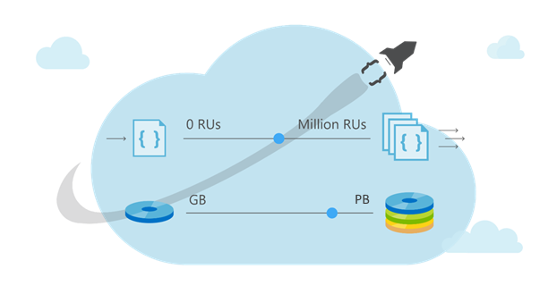
Cosmos DB Container (e.g. Collection)

Slide 72
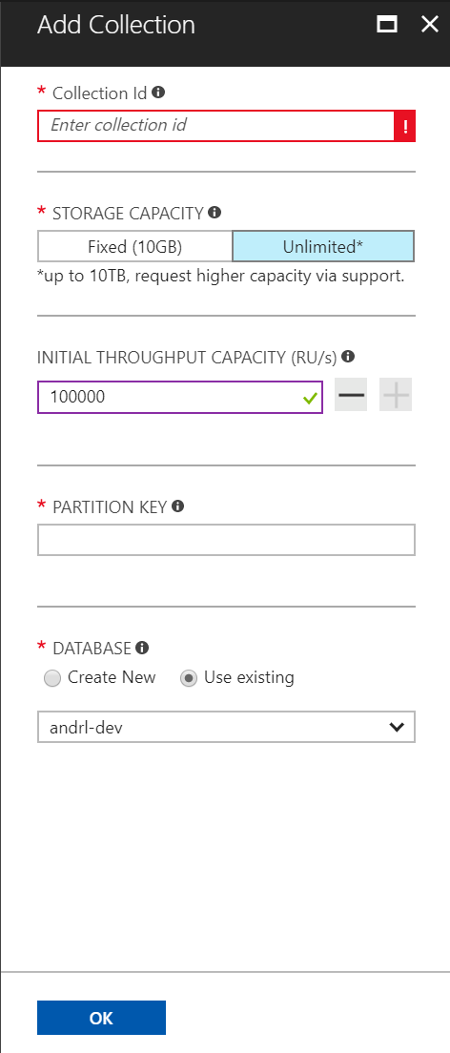
Cosmos DB Container (e.g. Collection)
Partitioning Scheme: top-most design decision in Cosmos DB

Slide 73
Cosmos DB Container (e.g. Collection)
Partition Key: User Id

Slide 74
Cosmos DB Container (e.g. Collection)
Partition Key: User Id
Logical Partitioning Abstraction
hash(User Id)
Behind the Scenes:
Physical Partition Sets
Psuedo-random distribution of data over
range of possible hashed values

Slide 75
Behind the Scenes:
Physical Partition Sets
hash(User Id)
….
Partition 1
Partition 2
Partition n
Frugal # of Partitions based on actual storage and throughput needs
(yielding scalability with low total cost of ownership)

Slide 76
Behind the Scenes:
Physical Partition Sets
hash(User Id)
….
Partition 1
Partition 2
Partition n
Frugal # of Partitions based on actual storage and throughput needs
(yielding scalability with low total cost of ownership)

Slide 77
Behind the Scenes:
Physical Partition Sets
hash(User Id)
Andrew
Dharma
Shireesh
Karthik
Rimma
Mike
Bob
….
Alice
Carol
…
…
Partition 1
Partition 2
Partition n
Frugal # of Partitions based on actual storage and throughput needs
(yielding scalability with low total cost of ownership)

Slide 78
Behind the Scenes:
Physical Partition Sets
hash(User Id)
Andrew
Dharma
Shireesh
Karthik
Rimma
Mike
Bob
….
Alice
Carol
…
…
Partition 1
Partition 2
Partition n
What happens when partitions need to grow?

Slide 79
Behind the Scenes:
Physical Partition Sets
hash(User Id)
Partition Ranges can be dynamically sub-divided
To seamlessly grow database as the application grows
While sedulously maintaining high availability
Dharma
Dharma
Rimma
Shireesh
Karthik
Rimma
+
Shireesh
Karthik
Alice
Carol
…
…
…
Partition X
Partition X1
Partition X2

Slide 80
Behind the Scenes:
Physical Partition Sets
hash(User Id)
Partition Ranges can be dynamically sub-divided
To seamlessly grow database as the application grows
While sedulously maintaining high availability
Best of All:
Partition management is completely taken care of by the system
You don’t have to lift a finger… the database takes care of you.
Dharma
Dharma
Rimma
Shireesh
Karthik
Rimma
+
Shireesh
Karthik
Alice
Carol
…
…
…
Partition X
Partition X1
Partition X2

Slide 81
Behind the Scenes:
Physical Partition Sets
hash(User Id)
[A-F]
[G-M]
[M-T]
[U-Z]
An easier way to think of consistent hashing is to project this range of hashed values as a ring.
[A-F]
[G-M]
[M-T]
[U-Z]

Slide 82
Behind the Scenes:
Physical Partition Sets
hash(User Id)
[A-F]
[G-M]
[M-T]
[U-W]
[X-Z]
An easier way to think of consistent hashing is to project this range of hashed values as a ring.
The database can elastically scale infinitely while maintaining high availability by minimizing data movement and subdividing partitions
[A-F]
[G-M]
[X-Z]
[M-T]
[U-W]

Slide 83
Cosmos DB Container (e.g. Collection)
Best Practices: Design Goals for Choosing a Good Partition Key
Distribute the overall request + storage volume
Avoid “hot” partition keys
Partition Key is scope for [efficient] queries and transactions
Queries can be intelligently routed via partition key
Omitting partition key on query requires fan-out

Slide 84
Cosmos DB Container (e.g. Collection)
Best Practices: Design Goals for Choosing a Good Partition Key
Distribute the overall request + storage volume
Avoid “hot” partition keys
Partition Key is scope for [efficient] queries and transactions
Queries can be intelligently routed via partition key
Omitting partition key on query requires fan-out
Steps for Success
Ballpark scale needs (size/throughput)
Understand the workload
# of reads/sec vs writes per sec
Use 80/20 rule to help optimize bulk of workload
For reads – understand top X queries (look for common filters)
For writes – understand transactional needs understand ratio of inserts vs updates

Slide 85
Cosmos DB Container (e.g. Collection)
Best Practices: Design Goals for Choosing a Good Partition Key
Distribute the overall request + storage volume
Avoid “hot” partition keys
Partition Key is scope for [efficient] queries and transactions
Queries can be intelligently routed via partition key
Omitting partition key on query requires fan-out
Steps for Success
Ballpark scale needs (size/throughput)
Understand the workload
# of reads/sec vs writes per sec
Use 80/20 rule to help optimize bulk of workload
For reads – understand top X queries (look for common filters)
For writes – understand transactional needs understand ratio of inserts vs updates
General Tips
Don’t be afraid of having too many partition keys
Partitions keys are logical
More partition keys => more scalability

Slide 86
Object Model Design

Slide 87
A few notes about containers
Containers do NOT enforce schema
There are benefits to co-locate multiple types in a container
Annotate records with a "type" property

Slide 88
Co-locating types in the same container
Ability to query across multiple entity types with a single network request.

Slide 89
Ability to query across multiple entity types with a single network request.
For example, we have two types of documents: cat and person.
{
"id": "Andrew",
"type": "Person",
"familyId": "Liu",
"worksOn": "Azure Cosmos DB"
}
{
"id": "Ralph",
"type": "Cat",
"familyId": "Liu",
"fur": {
"length": "short",
"color": "brown"
}
}

Slide 90
Ability to query across multiple entity types with a single network request.
For example, we have two types of documents: cat and person.
{
"id": "Andrew",
"type": "Person",
"familyId": "Liu",
"worksOn": "Azure Cosmos DB"
}
{
"id": "Ralph",
"type": "Cat",
"familyId": "Liu",
"fur": {
"length": "short",
"color": "brown"
}
}
We can query both types of documents without needing a JOIN simply by running a query without a filter on type:
SELECT * FROM c WHERE c.familyId = "Liu"

Slide 91
Ability to query across multiple entity types with a single network request.
For example, we have two types of documents: cat and person.
{
"id": "Andrew",
"type": "Person",
"familyId": "Liu",
"worksOn": "Azure Cosmos DB“
}
{
"id": "Ralph",
"type": "Cat",
"familyId": "Liu",
"fur": {
"length": "short",
"color": "brown"
}
}
If we wanted to filter on type = “Person”, we can simply add a filter on type to our query:
SELECT * FROM c WHERE c.familyId = "Liu" AND c.type = "Person"

Slide 92
Co-locating types in the same container
Ability to query across multiple entity types with a single network request.
Ability to perform transactions across multiple types

Slide 93
Global Distribution

Slide 94
Why Global Distribution
High Availability
Automatic and Manuel Failover
Multi-homing API removes need for app redeployment
Low Latency (anywhere in the world)
Packets cannot move fast than the speed of light
Sending a packet across the world under ideal network conditions takes 100’s of milliseconds
You can cheat the speed of light – using data locality
CDN’s solved this for static content
Azure Cosmos DB solves this for dynamic content
Notes:
Cosmos DB is a Foundational (Ring 0) Azure service
Available in all Azure regions by default, including sovereign/government clouds
Transparent and automatic multi-region replication
Associate any number of regions with your database account, at any time
Policy based geo-fencing
Multi-homing APIs
All endpoints are logical, by default
Apps don’t need to be redeployed during regional failover
Apps can also access physical endpoints if needed
Support for both manual and automatic failover
Designed for high availability
Allows for dynamically setting priorities to regions
Simulate regional disasters via API
Test the end-to-end availability for the entire app (beyond just the database)

Slide 95
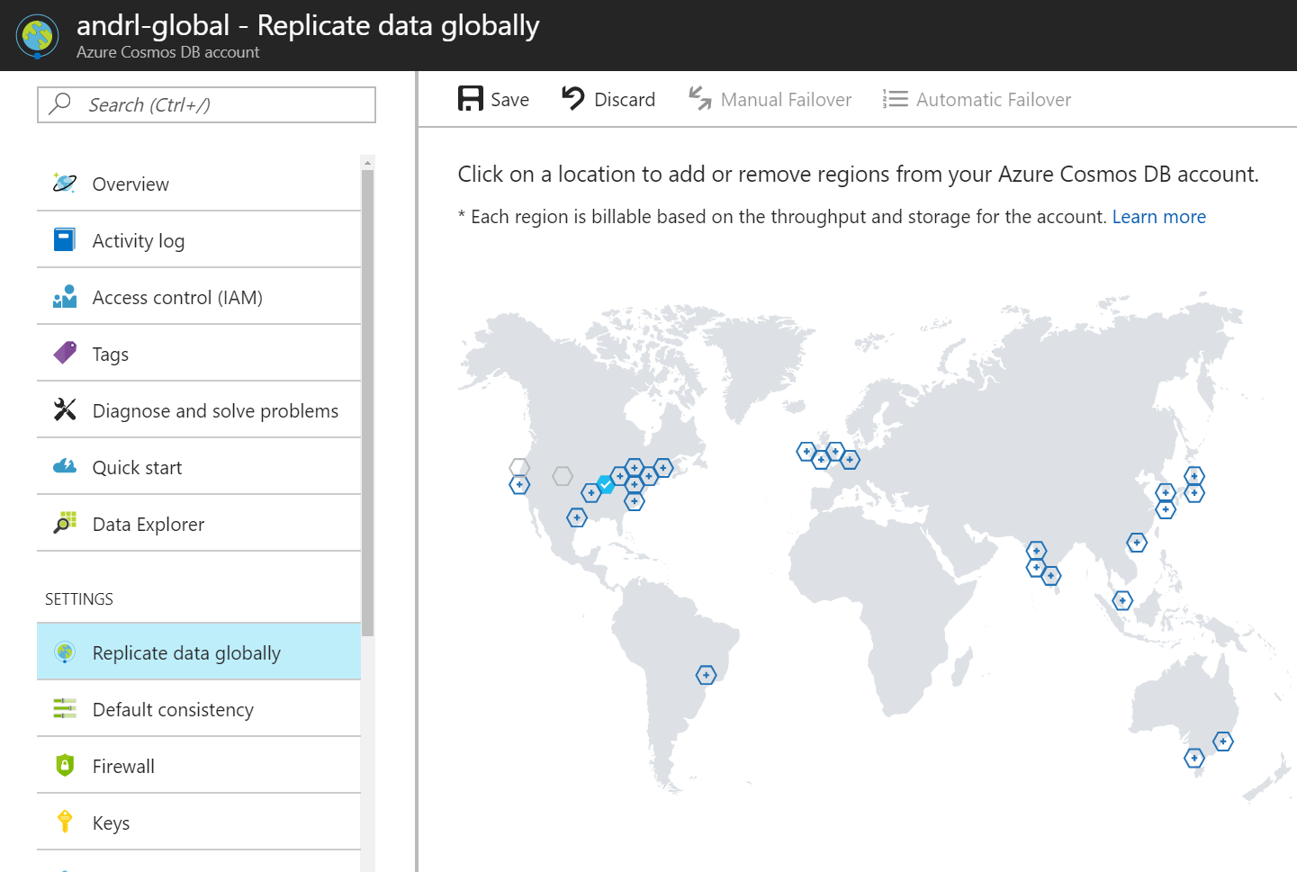

Slide 97
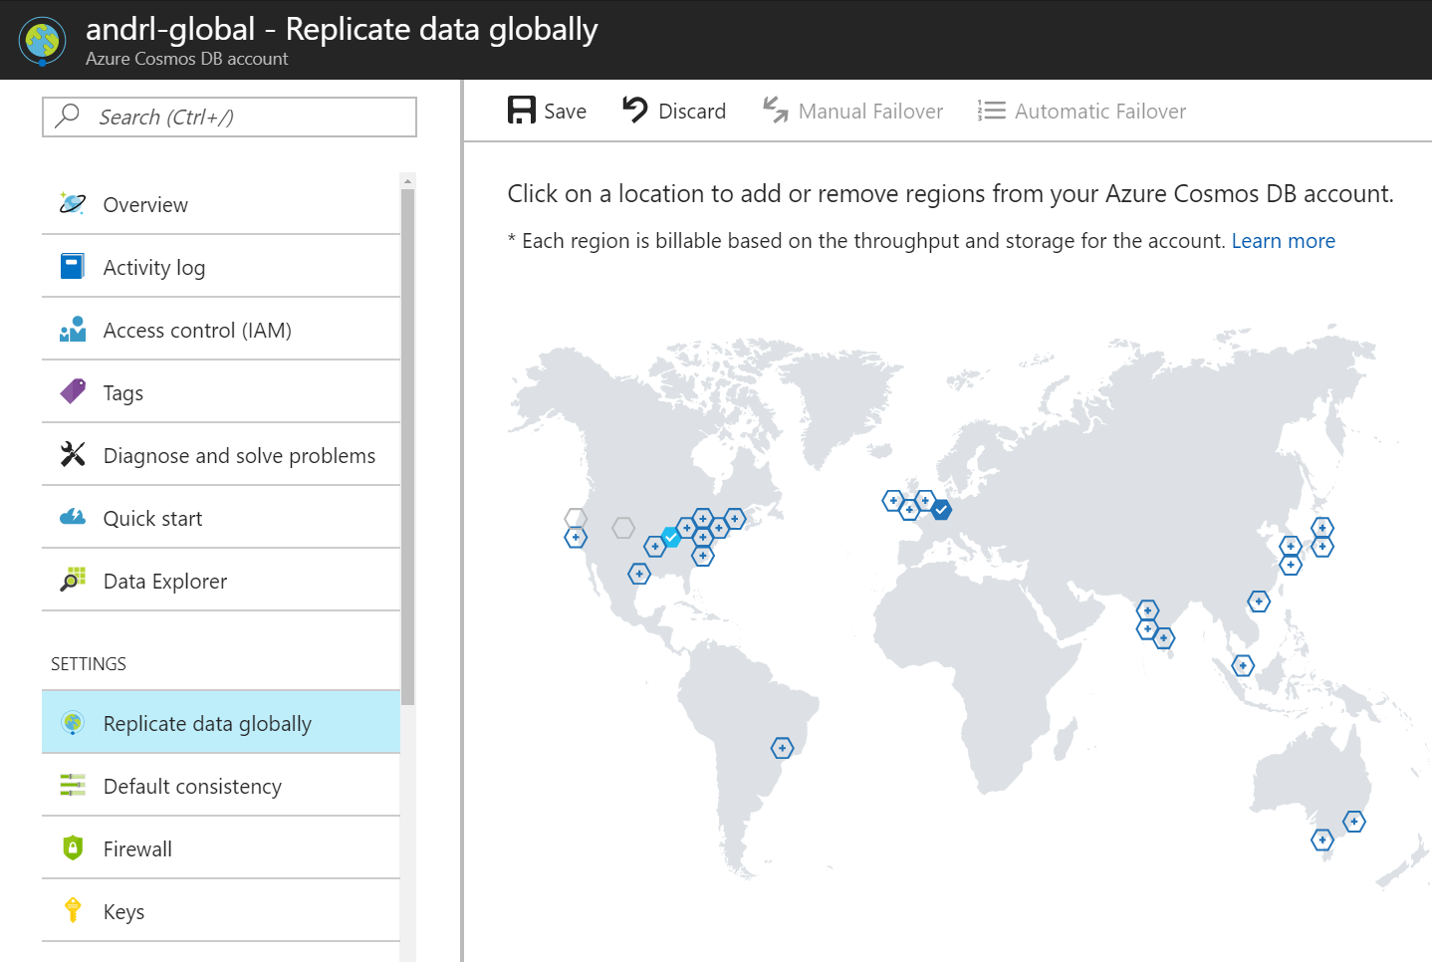

Slide 98


Slide 100
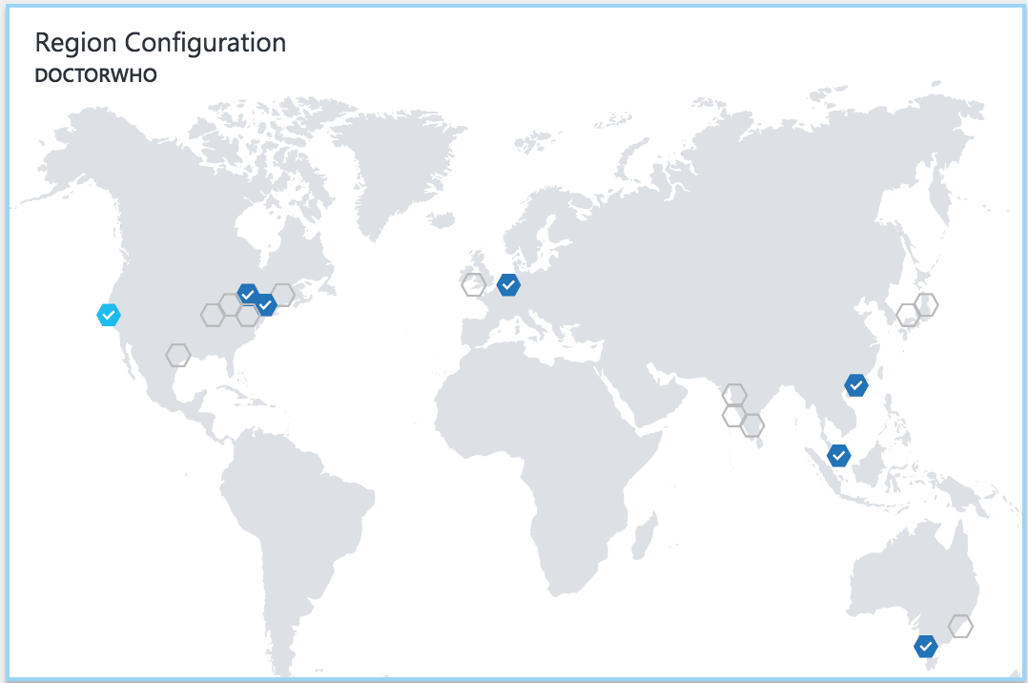


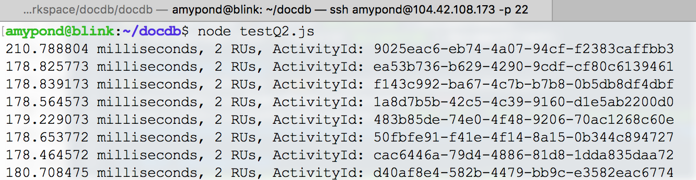

Slide 101
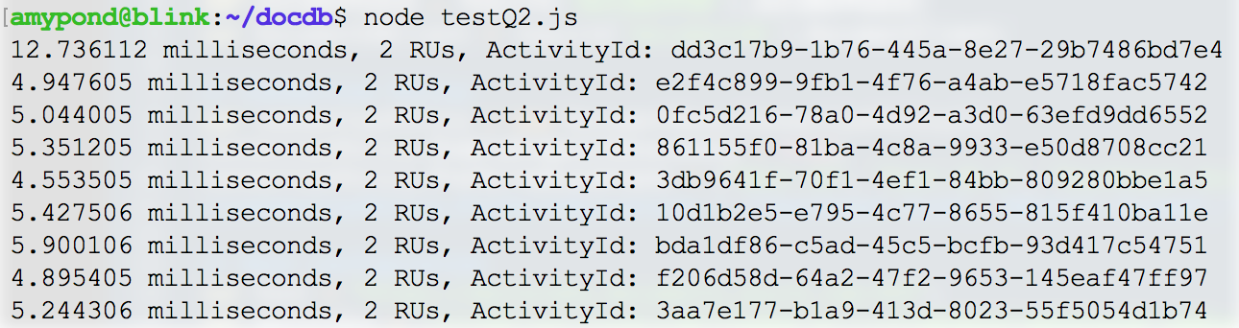

Slide 102
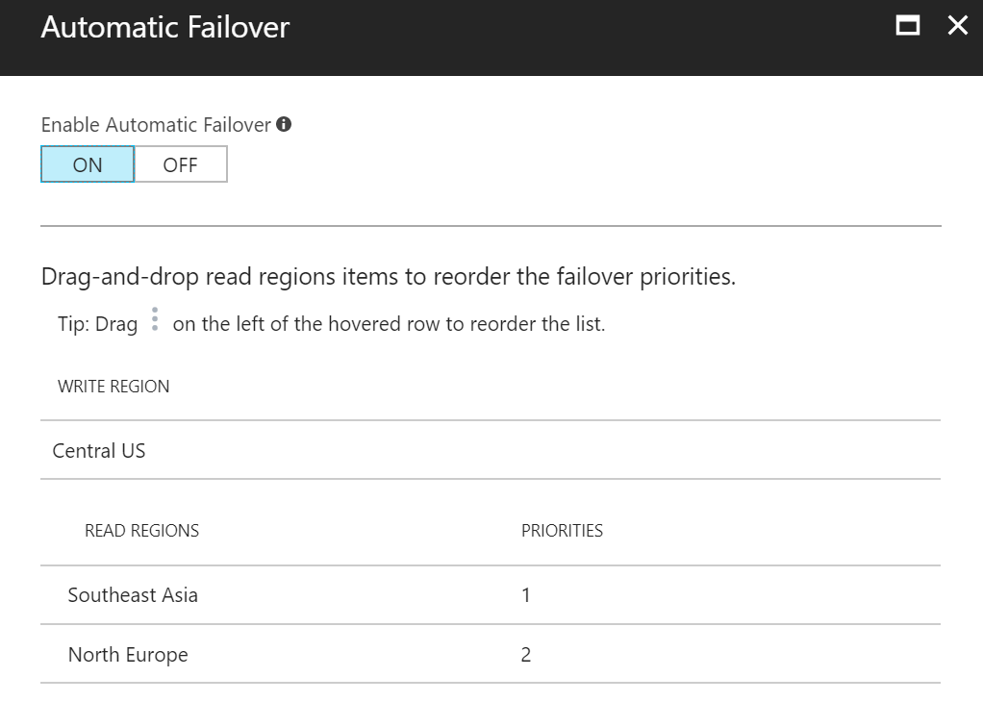

Slide 104
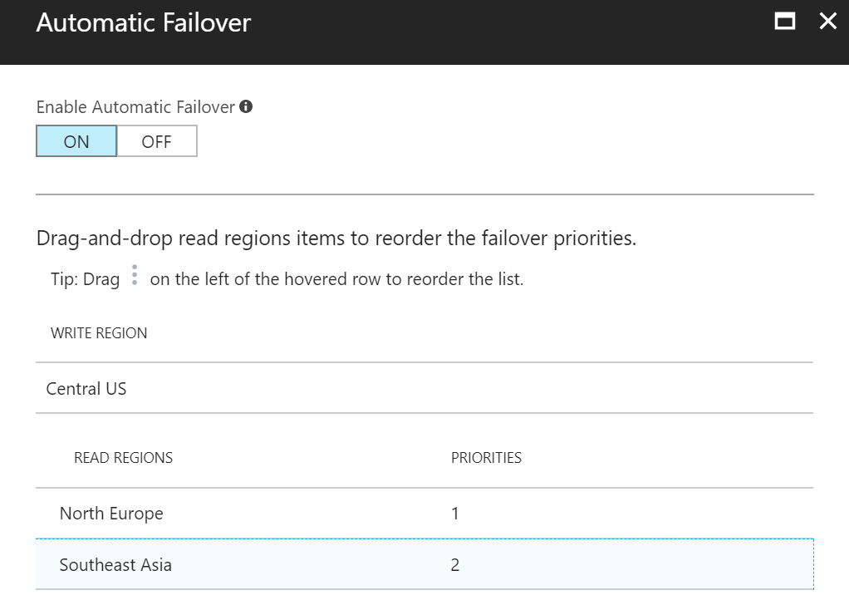
Note: For multi-master enabled accounts –
The priority list indicates which is the designated “hub” region for resolving write conflicts.

Slide 105
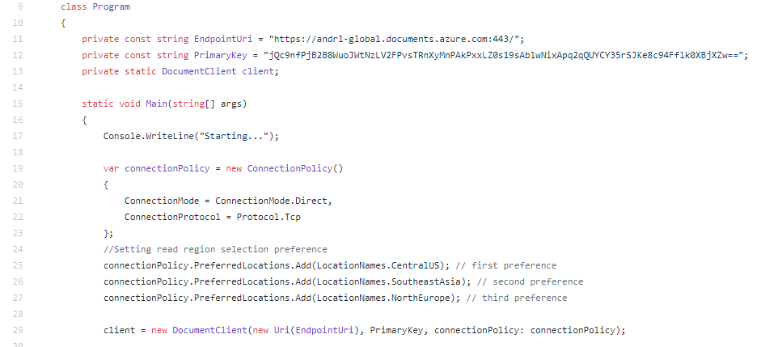

Slide 106
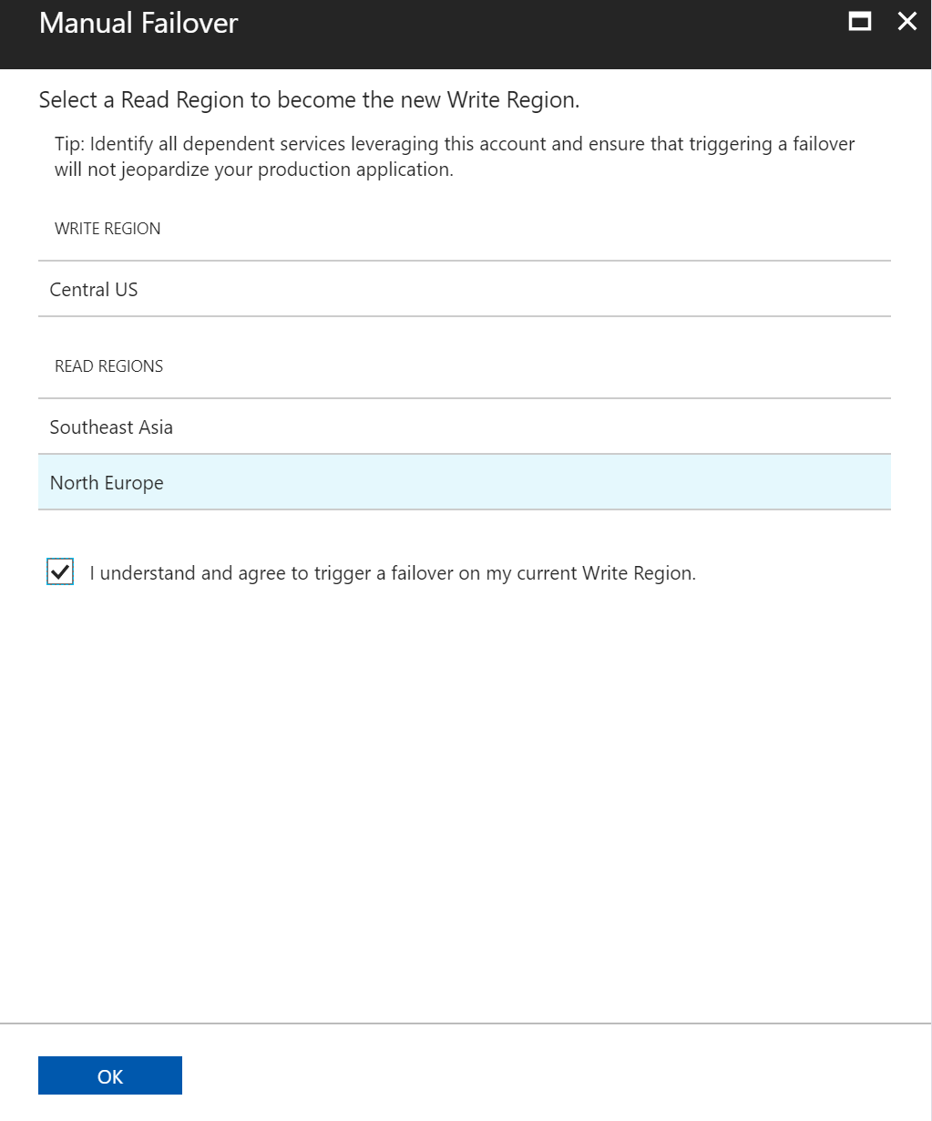

Slide 107
Consistency

Slide 108
ACID != CAP
Consistency w.r.t. Transactions is NOT the same thing as Consistency w.r.t. Replication.
this is about moving from one valid state to another for a single given tx
this about getting a consistent view across replicated copies of data

Slide 109
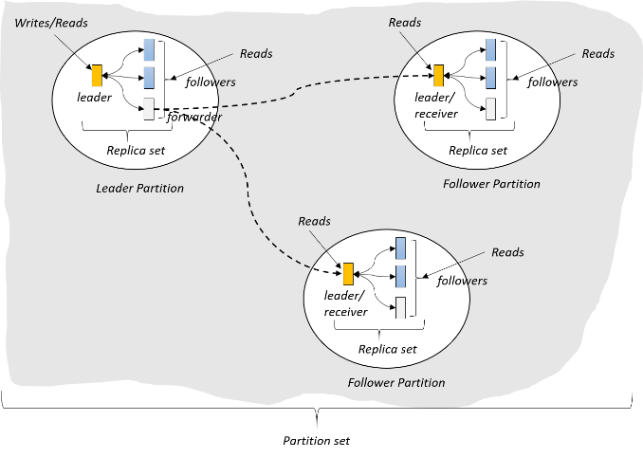
(West US)
(East US)
(North Europe)

Slide 110
Value = 5
Value = 5
Value = 5

Slide 111
Value = 5 6
Update 5 => 6
Value = 5
Value = 5

Slide 112
Value = 5 6
Update 5 => 6
Value = 5 6
Value = 5
What happens when a network partition is introduced?

Slide 113
Value = 5 6
Update 5 => 6
Value = 5 6
Value = 5
What happens when a network partition is introduced?
Reader: What is the value?
Should it see 5? (prioritize availability)
Or does the system go offline until network is restored? (prioritize consistency)

Slide 114
Brewer’s CAP Theorem: impossible for distributed data store to simultaneously provide more than 2 out of the following 3 guarantees:
Consistency, Availability, Partition Tolerance

Slide 115
Latency: packet of information can travel as fast as speed of light.
Replication between distant geographic regions can take 100’s of milliseconds
Value = 5 6
Update 5 => 6
Value = 5 6
Value = 5

Slide 116
Reader A: What is the value?
Value = 5 6
Update 5 => 6
Value = 5 6
Value = 5
Reader B: What is the value?

Slide 117
Reader A: What is the value?
Value = 5 6
Update 5 => 6
Value = 5 6
Value = 5
Reader B: What is the value?
Should it see 5 immediately? (prioritize latency)
Does it see the same result as reader A? (quorum impacts throughput)
Or does it sit and wait for 5 => 6 propagate? (prioritize consistency)

Slide 118
PACELC Theorem: In the case of network partitioning (P) in a distributed computer system, one has to choose between availability (A) and consistency (C) (as per the CAP theorem), but else (E), even when the system is running normally in the absence of partitions, one has to choose between latency (L) and consistency (C).

Slide 119

Programmable Data Consistency
Choice for most distributed apps
Strong consistency High latency
Eventual consistency, Low latency

Slide 120
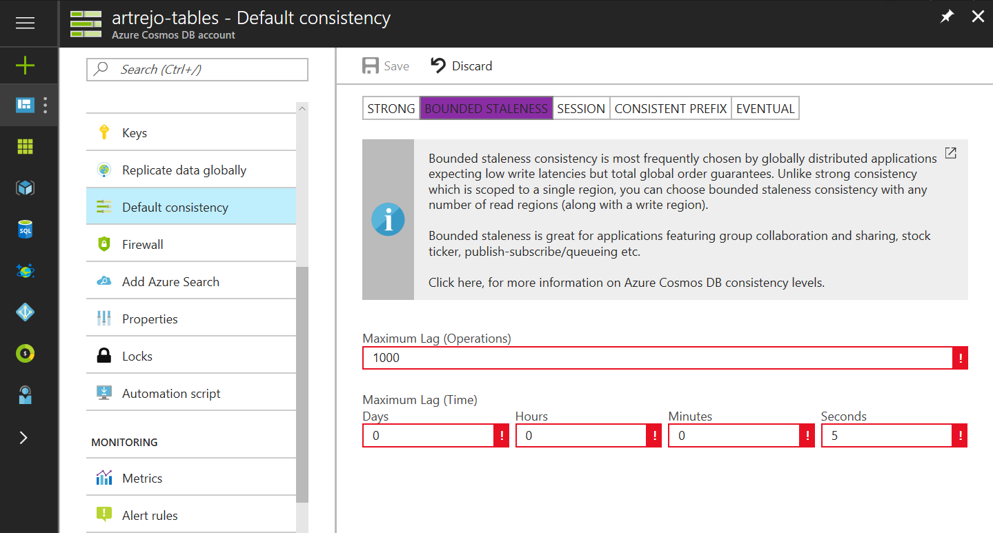

Well-defined consistency models
Intuitive programming model
5 Well-defined, consistency models
Overridable on a per-request basis
Clear tradeoffs
Latency
Availability
Throughput

Slide 121
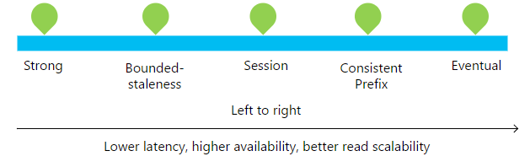

Slide 122
Consistency Level | Guarantees
Strong | Linearizability (once operation is complete, it will be visible to all)
Bounded Staleness | Consistent Prefix. Reads lag behind writes by at most k prefixes or t interval Similar properties to strong consistency (except within staleness window), while preserving 99.99% availability and low latency.
Session | Consistent Prefix. Within a session: monotonic reads, monotonic writes, read-your-writes, write-follows-reads Predictable consistency for a session, high read throughput + low latency
Consistent Prefix | Reads will never see out of order writes (no gaps).
Eventual | Potential for out of order reads. Lowest cost for reads of all consistency levels.

Slide 123
Bounded-Staleness: Bounds are set server-side via the Azure Portal

Slide 124
Session Consistency: Session is controlled using a “session token”.
Session tokens are automatically cached by the Client SDK
Can be pulled out and used to override other requests (to preserve session between multiple clients)
string sessionToken;
using (DocumentClient client = new DocumentClient(new Uri(""), ""))
{
ResourceResponse<Document> response = client.CreateDocumentAsync(
collectionLink,
new { id = "an id", value = "some value" }
).Result;
sessionToken = response.SessionToken;
}
using (DocumentClient client = new DocumentClient(new Uri(""), ""))
{
ResourceResponse<Document> read = client.ReadDocumentAsync(
documentLink,
new RequestOptions { SessionToken = sessionToken }
).Result;
}

Slide 125
Consistency can be relaxed on a per-request basis
client.ReadDocumentAsync(
documentLink,
new RequestOptions { ConsistencyLevel = ConsistencyLevel.Eventual }
);

Slide 126
Indexing

Slide 127
Schema-agnostic, automatic indexing
Automatically index every property of every record without having to define schemas and indices upfront.
No need for schema and index management
Works across every data model
Latch free data structure for highly write-optimized database engine
Multiple index types: Hash, range, and geospatial
Schema
Physical index
Notes:
At global scale, schema/index management is hard
Automatic and synchronous indexing of all ingested content - hash, range, geo-spatial, and columnar
No need to define schemas or secondary indices upfront
Resource governed, write optimized database engine with latch free and log structured techniques
Online and in-situ index transformations

Slide 128
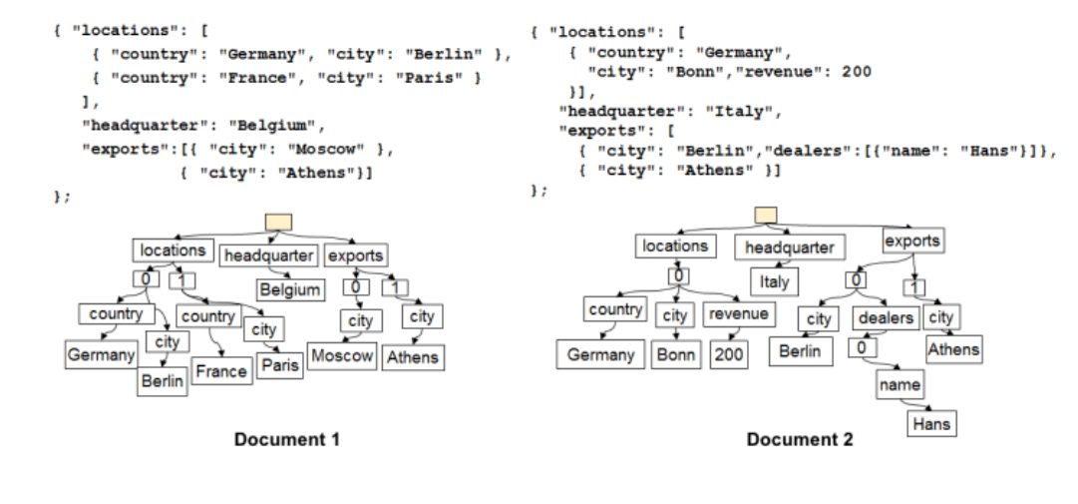

Slide 129
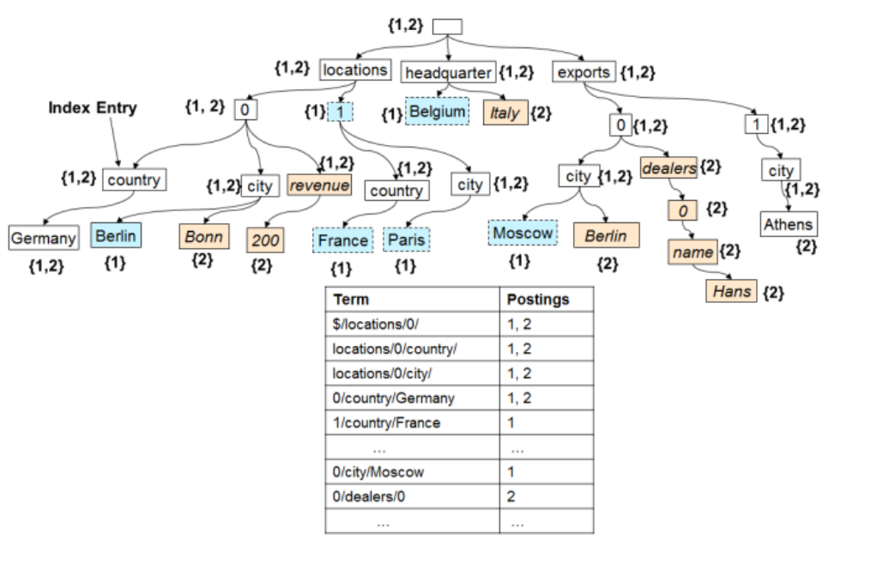

Slide 130
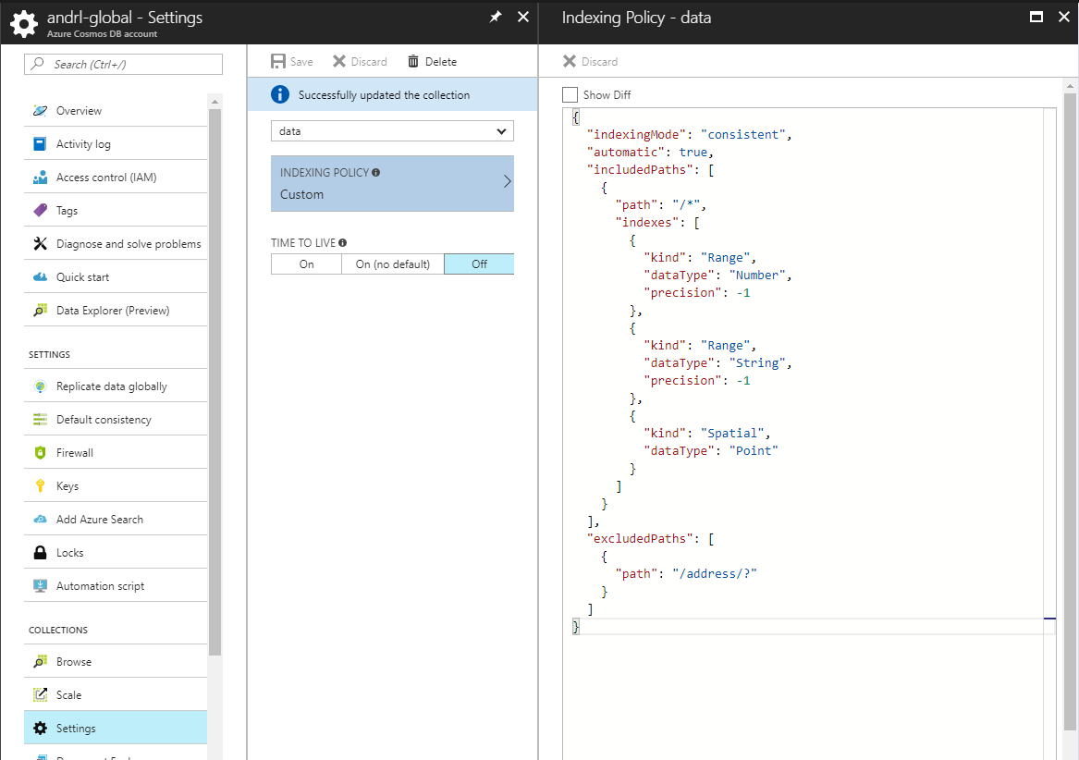

Slide 131
SQL API

Slide 132
Query Demo:
https://www.documentdb.com/sql/demo

Slide 133
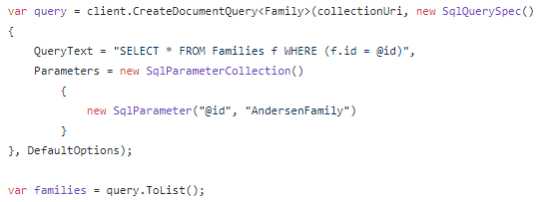
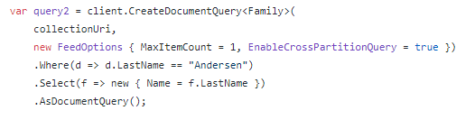
SQL API
Example: SQL Parameterization
Example: LINQ

Slide 134
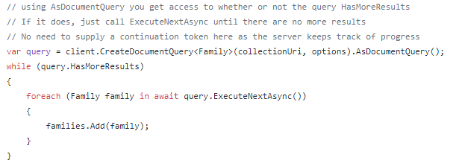
SQL API
Query Results are paginated:
ToList() automatically iterates through all pages:

Slide 135
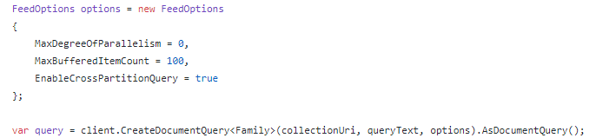
SQL API
Cross-Partition Queries

Slide 136
Concurrency

Slide 137
Write Optimized Database Engine
Designed for sustained large write volume without any term locality
Lock free; threads never block
Log structured with large elastic writes
Blind incremental updates
Low write, read, and space amplification
Index updates must operate within frugal resource budgets
Optimistic Concurrency Control via etag property
B-Tree
Cache
Log Structured Store
In memory
Notes:
Single machine is never a bottleneck
A single table can scale from GB-PBs, across many machines, and regions
Transparent server side partition management and routing
Optionally evict old data using built-in support for TTL
Customers pay only for the throughput and storage they need
Elastically scale throughput from 10 to 100s of millions of requests/sec across multiple regions
Customers pay only for the throughput and storage they need
Customers pay by the hour for the provisioned throughput

Slide 138
Optimistic Concurrency Control
{
"id": "2c9cddbb-a011-4947-94c2-6f8ccf421d2e",
"_rid": "o8ExAJlS4xRIAAAAAAAAAA==",
"_self": "dbs/o8ExAA==/colls/o8ExAJlS4xQ=/docs/o8ExAJlS4xRIAAAAAAAAAA==/",
"_etag": "\"2e004542-0000-0000-0000-5af31e8c0000\"",
"_attachments": "attachments/",
"_ts": 1525882508
}

Slide 139
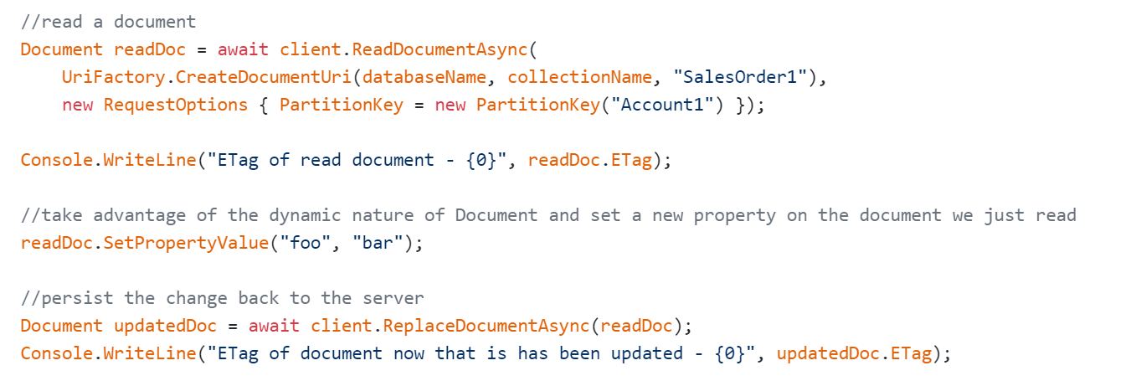
Optimistic Concurrency Control

Slide 140
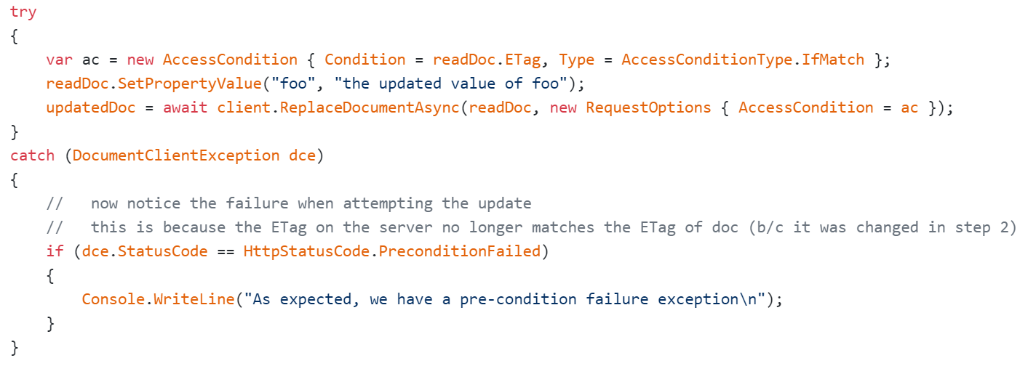
Optimistic Concurrency Control

Slide 141
Transactions

Slide 142
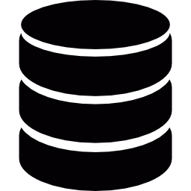
JavaScript Language Integrated Transactions
Context Pool
ACID transactions over multiple records scoped to a partition key
Rich programming model via Stored Procedures
Exposed via a JavaScript as a modern day T-SQL
Snapshot isolation at beginning of script invocation
Writes gets atomically committed upon successful script invocation
Exceptions (via “throw” keyword) rolls back the transaction
…
…
Compiled JavaScript
…
Store
REPLACE
QUERY
REPLACE
…
To other replicas
Transaction
Notes:
Single machine is never a bottleneck
A single table can scale from GB-PBs, across many machines, and regions
Transparent server side partition management and routing
Optionally evict old data using built-in support for TTL
Customers pay only for the throughput and storage they need
Elastically scale throughput from 10 to 100s of millions of requests/sec across multiple regions
Customers pay only for the throughput and storage they need
Customers pay by the hour for the provisioned throughput

Slide 143
JavaScript Language Integrated Transactions
ACID transactions over multiple records scoped to a partition key
Rich programming model via Stored Procedures
Exposed via a JavaScript as a modern day T-SQL
Snapshot isolation at beginning of script invocation
Writes gets atomically committed upon successful script invocation
System checks for e-tag violations at commit time to avoid conflict
Exceptions (via “throw” keyword) rolls back the transaction
function(playerId1, playerId2) { var playersToSwap = __.filter (function (document) { return (document.id == playerId1 || document.id == playerId2); }); var player1 = playersToSwap[0], player2 = playersToSwap[1]; var player1ItemTemp = player1.item; player1.item = player2.item; player2.item = player1ItemTemp;
__.replace(player1) .then(function() { return __.replace (player2); }) .fail(function(error){ throw 'Unable to update players, abort'; }); }
Notes:
Single machine is never a bottleneck
A single table can scale from GB-PBs, across many machines, and regions
Transparent server side partition management and routing
Optionally evict old data using built-in support for TTL
Customers pay only for the throughput and storage they need
Elastically scale throughput from 10 to 100s of millions of requests/sec across multiple regions
Customers pay only for the throughput and storage they need
Customers pay by the hour for the provisioned throughput

Slide 144
Stored Procedures Best Practices + Caveats
ACID transactions across multiple records in a distributed system involves tradeoffs:
These are laws of physics – cannot be avoided
Transactions across multiple machines require expensive coordination – common approach is 2 phase commit
Providing isolation against read/write skew against other concurrent transactions also involve concurrency tradeoffs
Guidelines & Best Practices:
Sprocs must be scoped to a partition key value
Sprocs have bounded execution (5 second rule)
CRUD methods expose an isAccepted API to help script detect when it is nearing execution boundary
Long running transactions should be broken up in to “chunks” with a continuation model
Ex: return a Boolean indicating whether transaction is done, and include metadata (_ts watermark or pointer) to help resume business logic
Sprocs are implemented via JS – use callback convention to serialize control flow and avoid queueing up too many async requests
Tip: avoid deserializing string => object input unless required – this uses unnecessary CPU / RUs

Slide 145
Change Feed

Slide 146
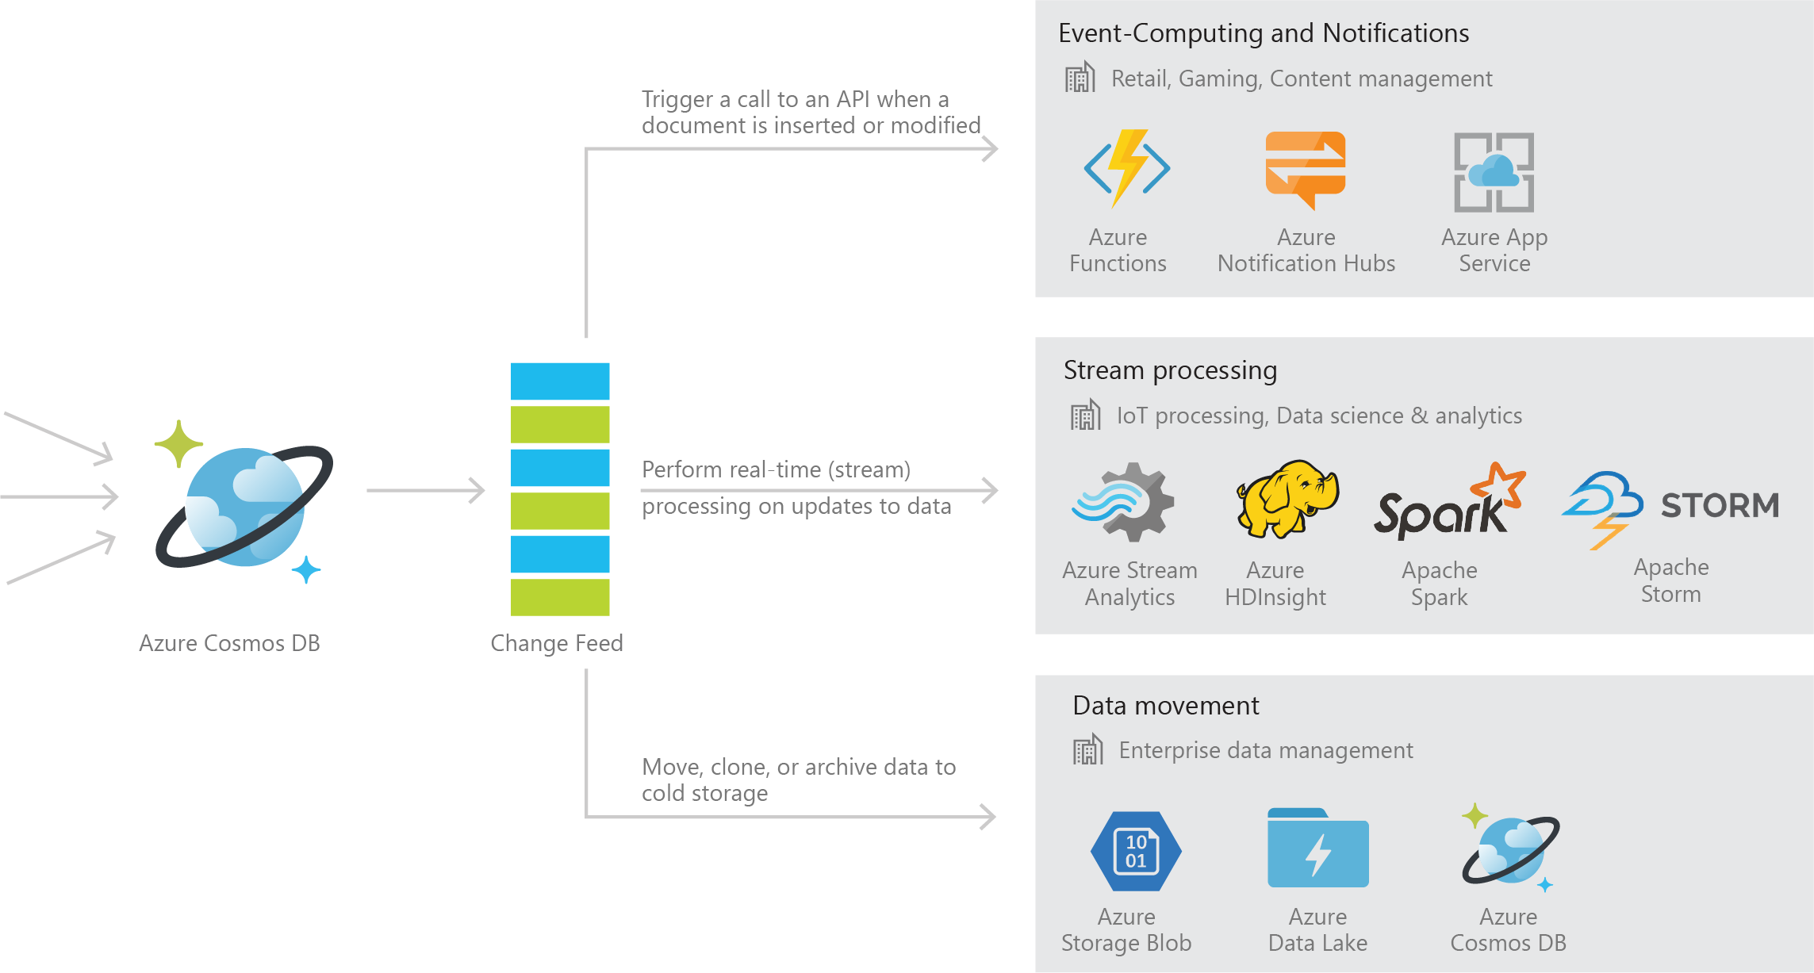
Azure Cosmos DB Change Feed
Persistent log of records within an Azure Cosmos DB container in the order in which they were modified

Slide 147
Common Scenarios

Slide 148

Event Sourcing for Microservices
Trigger Action From Change Feed
Persistent Event Store
Microservice
#1
Microservice #2
New Event
…
Microservice #N

Slide 149
Materializing Views
Application
Cosmos DB
Materialized View
Subscription | User | Create Date | …
123abc | Ben6 | 6/17/17
456efg | Ben6 | 3/14/17
789hij | Jen4 | 8/1/16
012klm | Joe3 | 3/4/17
User | Total Subscriptions
Ben6 | 2
Jen4 | 1
Joe3 | 1

Slide 150
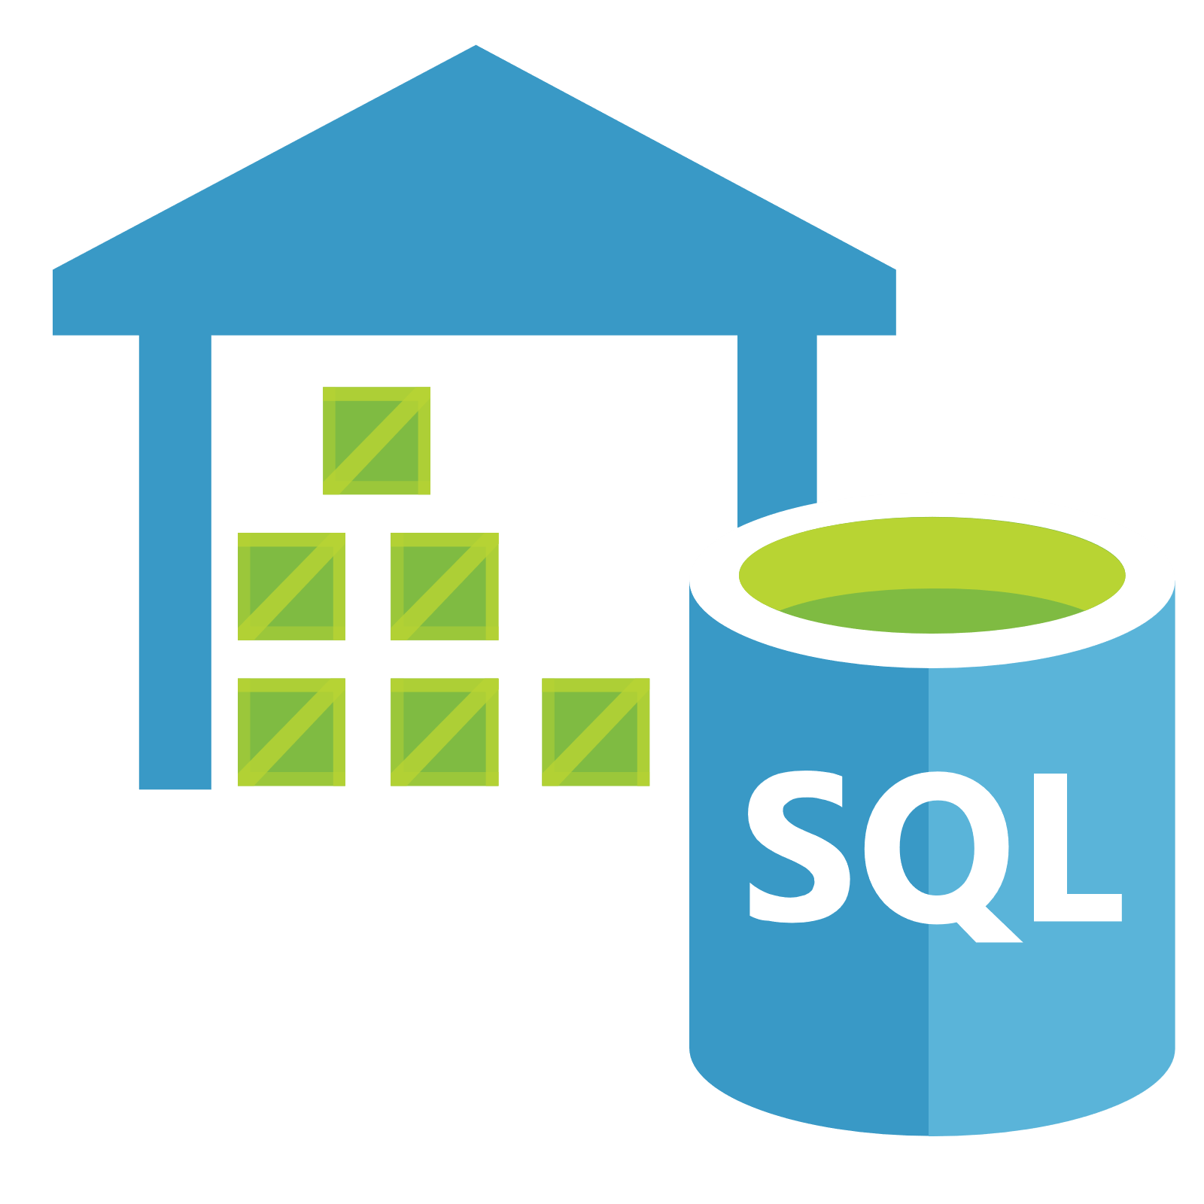

Replicating Data
Secondary Datastore (e.g. archive)
Replicate Records
CRUD Data

Slide 151
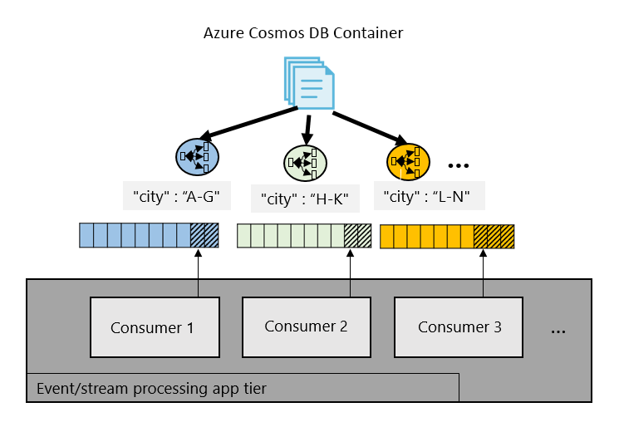
Working with Change Feed

Slide 152
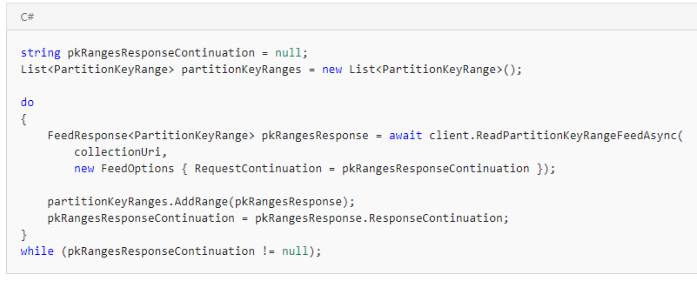
Working with Change Feed
Step 1: Retrieve a list of the partition key ranges

Slide 153
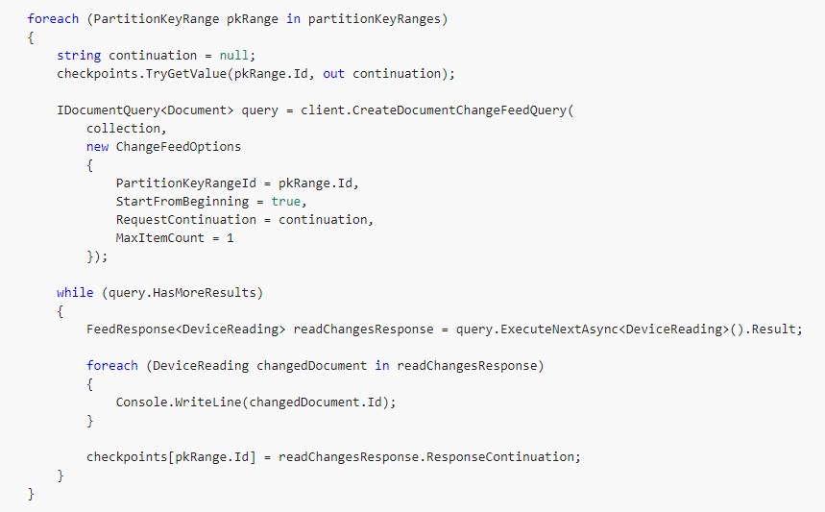
Working with Change Feed
Step 2: Consume the Change Feed on each PartitionKeyRange

Slide 154
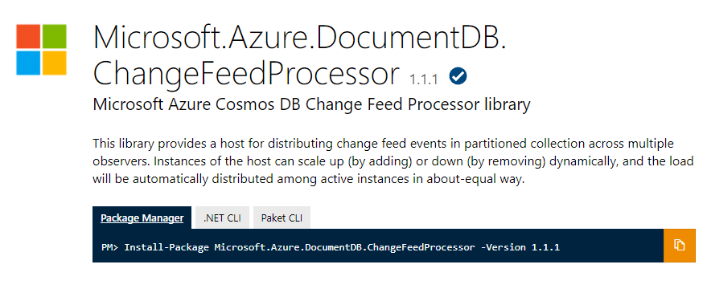
Change Feed Processor Library

Slide 155
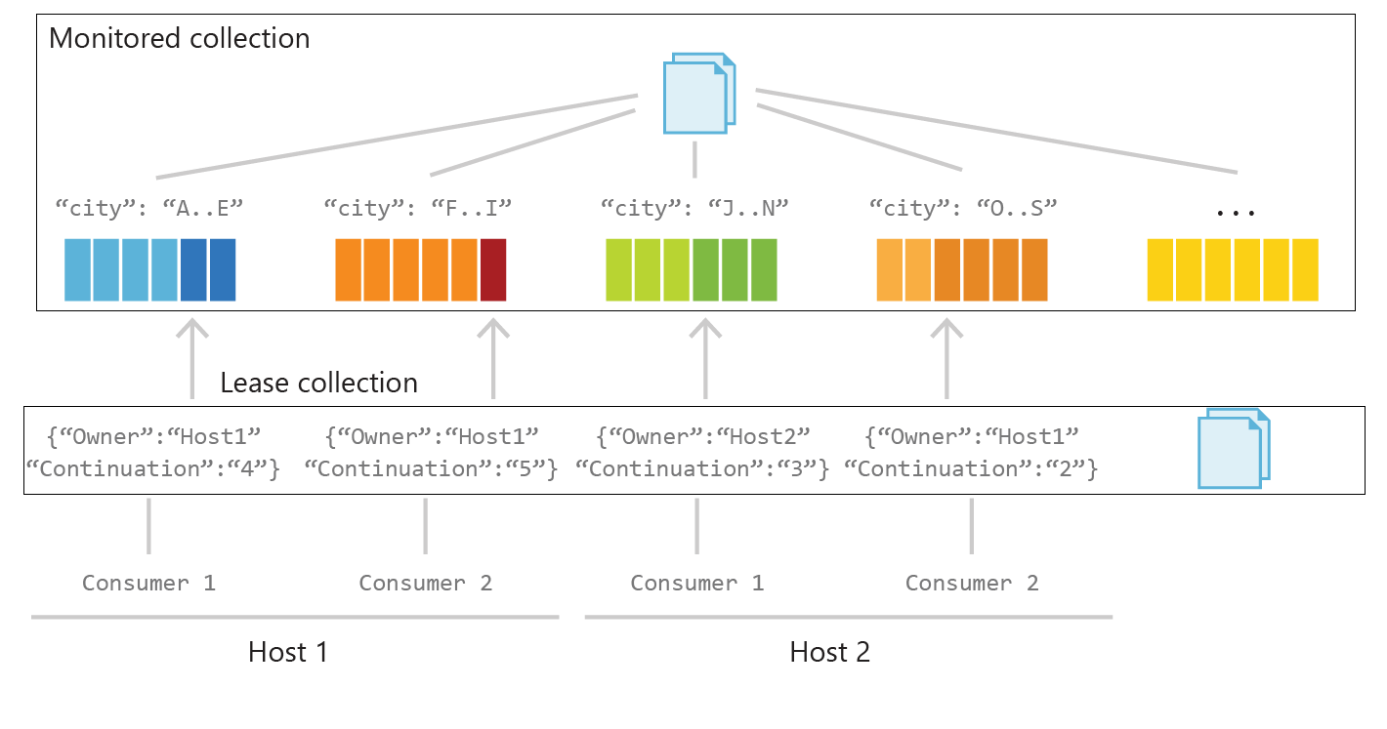
Behind the Scenes

Slide 156
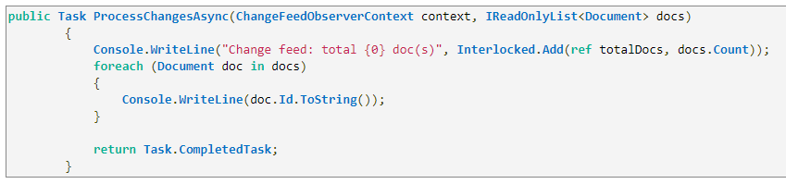
Working with Change Feed Processor Library
Step 1: Implement ProcessChangesAsync() on IChangeFeedObserver

Slide 157
Working with Change Feed Processor Library
Step 2: Register the IChangeFeedObserver with to a ChangeFeedEventHost

Slide 158
Security & Compliance
Always encrypted at rest and in transit
Encryption@ Rest – AES256
Encryption @ Transit – SSL / TLS
Fine grained “row level” authorization
User/Permissions with Resource Tokens
Network security with IP firewall rules and VNET
Comprehensive Azure compliance certification:
ISO 27001, ISO 27018, EUMC, HIPAA
PCI, SOC1 and SOC2
FEDRAMP, HITRUST
Notes:
As a foundational Azure Service, Security and Compliance is an important aspect of Azure Cosmos DB. Several high value Microsoft services that have stringent compliance and security requirements are built on Azure Cosmos DB. All of the data is encrypted at rest and it is enabled by default. We made sure that we continue to provide the performance guarantees even with encryption enabled and this is transparent to your application.

Slide 159
A few more tips & tricks

Slide 160
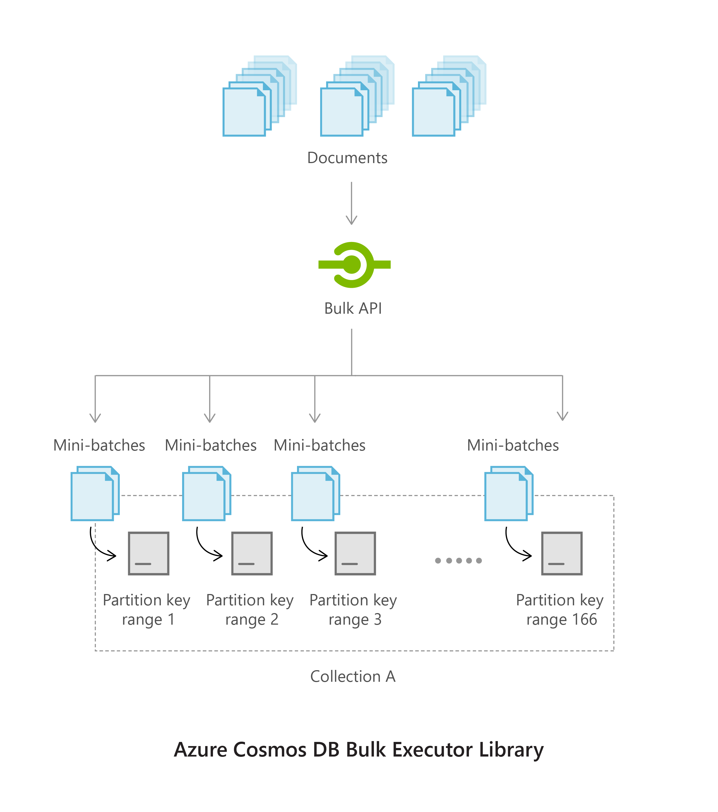
Bulk Executor Library
Supports bulk import and update
Auto handles congestion control + transient errors
10x client-side performance improvement
Available for .NET and Java
Notes:
As a foundational Azure Service, Security and Compliance is an important aspect of Azure Cosmos DB. Several high value Microsoft services that have stringent compliance and security requirements are built on Azure Cosmos DB. All of the data is encrypted at rest and it is enabled by default. We made sure that we continue to provide the performance guarantees even with encryption enabled and this is transparent to your application.

Slide 161




Azure Cosmos DB + Apache Spark
Spark master node connects to the Cosmos DB gateway node
Metadata is returned to Spark master node
Query is executed from Spark worker nodes in parallel to the Cosmos DB data nodes
Query results are returned from the Cosmos DB data nodes to the Spark worker nodes.
gateway
node
1
data
nodes
2
master
node
3
Spark-DocumentDB
Connector (Java)
worker nodes
4
Notes:
As a foundational Azure Service, Security and Compliance is an important aspect of Azure Cosmos DB. Several high value Microsoft services that have stringent compliance and security requirements are built on Azure Cosmos DB. All of the data is encrypted at rest and it is enabled by default. We made sure that we continue to provide the performance guarantees even with encryption enabled and this is transparent to your application.

Slide 162
Components of a Lambda Architecture
All data pushed into both batch and speed layer for processing
The batch layer has a master dataset (immutable, append-only set of raw data) and pre-compute the batch views
The serving layer has batch views so data available for fast queries.
The speed layer compensates for processing time (to serving layer) and deals with recent data only.
All queries can be answered by merging results from batch views and real-time views.
Source: http://lambda-architecture.net/
batch layer
serving layer
pre-compute
batch view
2
3
master dataset
batch view
5
new data
query
1
speed layer
4
real-time view
real-time view
Notes:
As a foundational Azure Service, Security and Compliance is an important aspect of Azure Cosmos DB. Several high value Microsoft services that have stringent compliance and security requirements are built on Azure Cosmos DB. All of the data is encrypted at rest and it is enabled by default. We made sure that we continue to provide the performance guarantees even with encryption enabled and this is transparent to your application.

Slide 163




Lambda Architecture Simplified
All data pushed into both batch and speed layer for processing
The batch layer has a master dataset (immutable, append-only set of raw data) and pre-compute the batch views
The serving layer has batch views so data available for fast queries.
The speed layer compensates for processing time (to serving layer) and deals with recent data only.
All queries can be answered by merging results from batch views and real-time views.
1
new data
collections
computed RT
CosmosDB change feed
2
master dataset
4
4
3
computed batch
3
pre-compute
batch
5
2
query
Notes:
As a foundational Azure Service, Security and Compliance is an important aspect of Azure Cosmos DB. Several high value Microsoft services that have stringent compliance and security requirements are built on Azure Cosmos DB. All of the data is encrypted at rest and it is enabled by default. We made sure that we continue to provide the performance guarantees even with encryption enabled and this is transparent to your application.

Slide 164
Trouble Shooting Guide

Slide 165
Troubleshooting 429s – Rate Limited Calls
Master Resource Throttling?
High RU charges for Operations in the time window of rate limited calls?
High volume of requests (even though RU charges are low?)
Yes
No
Repeated unnecessary calls to “Master” resources?
Read Collection
Read Offer
Read Database
Multiple Client instances
Queries?
Ingestion Path?
Create/Replace/Upsert
Skew in the data?
Is there an uneven distribution of data and/or requests across partition keys?
Is the cardinality of the partition key too low?
Read-only Stored Procedures?
Sproc are optimized for atomically and transactionally writing multiple records
Not ideal for read-only procedural logic
Re-write read-only logic as query/read operations
Refactor Data Model Design
Follow this guide for best practices on partitioning -https://docs.microsoft.com/en-us/azure/cosmos-db/partition-data
Navigate to Troubleshooting Query Performance slide
Navigate to Troubleshooting Ingestion Performance slide
Re-use singleton instance of client and refactor redundant calls

Slide 166
Troubleshooting Query Performance
High RU Charges for Query Operations?
High Query latencies?
Queries on id?
Are these aggregate queries?
Sorting on a field with a large number of distinct values? e.g. timestamp?
Ask for QueryMetrics https://docs.microsoft.com/en-us/azure/cosmos-db/sql-api-sql-query-metrics#query-execution-metrics
Are there a large number of cross partition queries?
Are there a large number of physical partitions for the collection?
Mongo API?
Cross partition queries in Mongo are serial. These queries are expected to have high latencies.
Control the degree of parallelism instead of setting MaxDegreeOfParallelism to -1
This will ensure x number of partitions are executed against in parallel
Contact support for help re-tuning queries
Use read document over query document
Contact support to preview upcoming indexing improvements
Materialized a view to offload some computation from read path to write path
Run aggregations client side
Store results of aggregations in a second collection
Use ChangeFeed library to reduce latency for generating real-time views https://docs.microsoft.com/en-us/azure/cosmos-db/change-feed
Use read document over query document
Contact support to preview upcoming indexing improvements

Slide 167
Troubleshooting Ingestion Performance
High RU Charges for Ingestion Operations?
Large documents?
Default Indexing policy with a large number of fields?
Is the BulkExecutor being used?
Try BulkExecutor if not already using
Can the documents be split into multiple documents?
This can reduce the scope and RU cost of updates. While total RUs consumed for other operations will be approximately the same, records can partially succeed instead of rate limiting large chunks
Default indexing indexes on all fields by default. This might be unnecessary
If only a known subset of fields will be used as filters on queries, the indexing policy can be modified to only include those fields – this has empirically proven to show large improvements in throughput utilization
https://docs.microsoft.com/en-us/azure/cosmos-db/indexing-policies#index-paths

Slide 168
General Performance Troubleshooting
What is the memory usage on the VM?
Linux VMs?
Are you bottlenecked by max file size (i.e. no of open connections)?
i.e. nofiles
General/High Level Troubleshooting
What is the CPU utilization on the VM?
How many threads are being executed in parallel?
- Does the VM have sufficient cores?
How many client instances are being created per process? Ideally, the number of instances should be limited to 1 per process.

Slide 169


Thank you and Q&A
Follow @AzureCosmosDB
Use #CosmosDB
cosmosdb.com
#azure-cosmosdb

